Slide 1
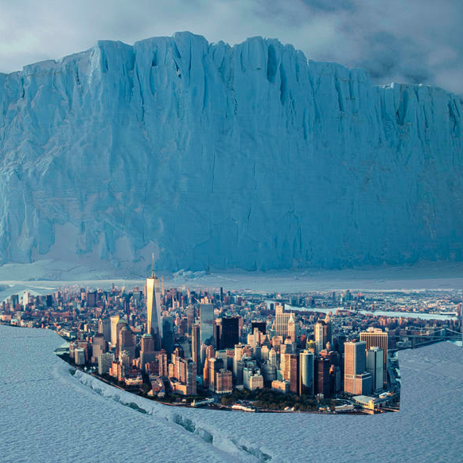
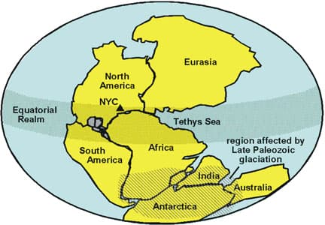
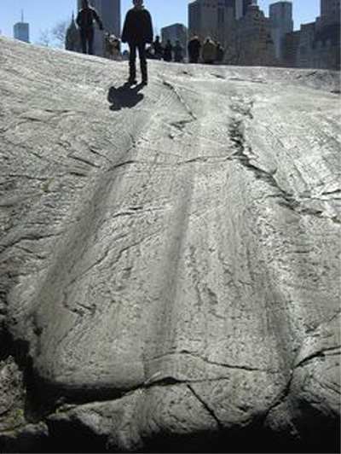
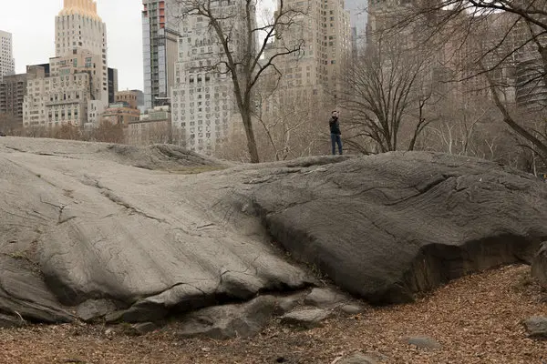
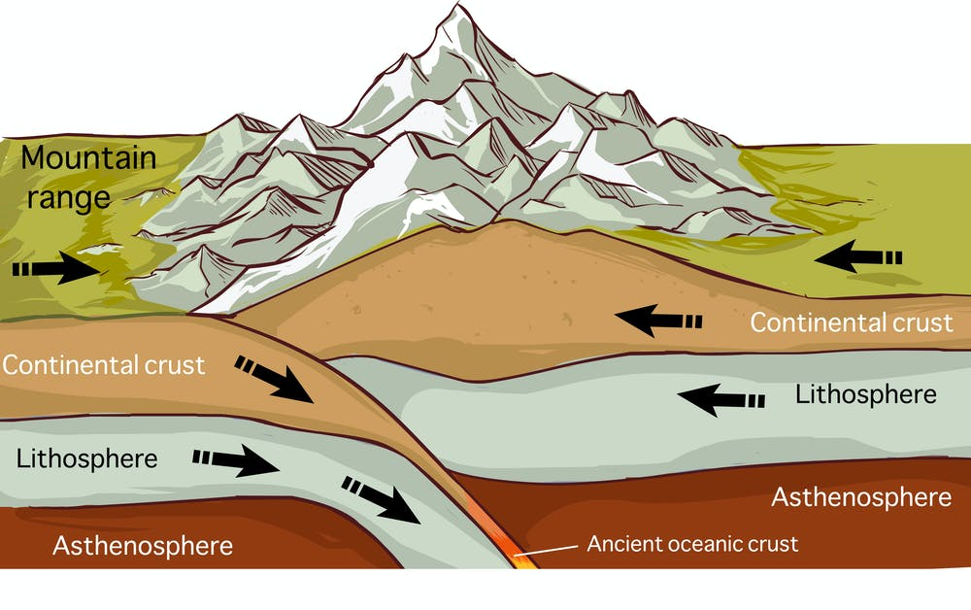
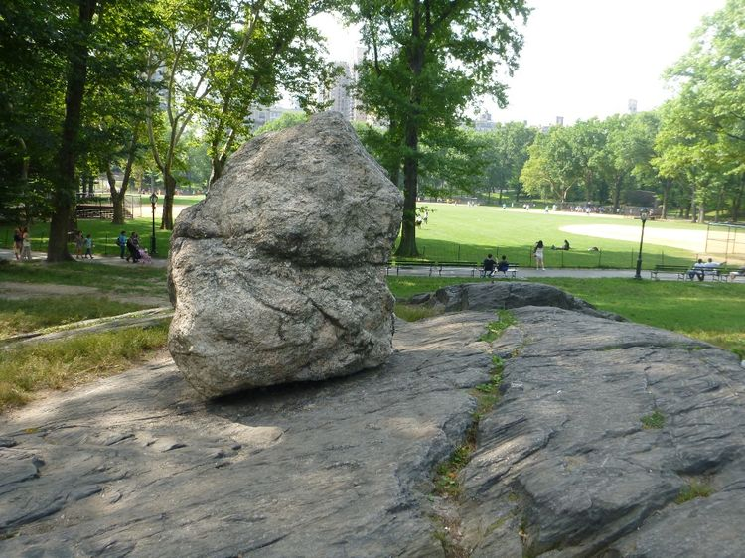
Geological History of NYC

Slide 2
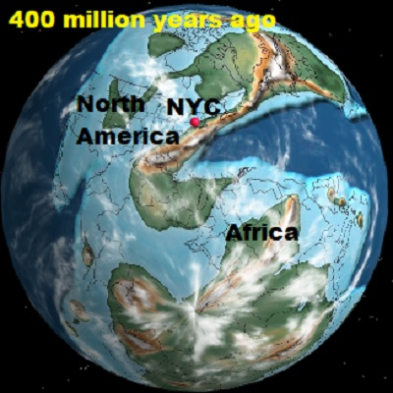
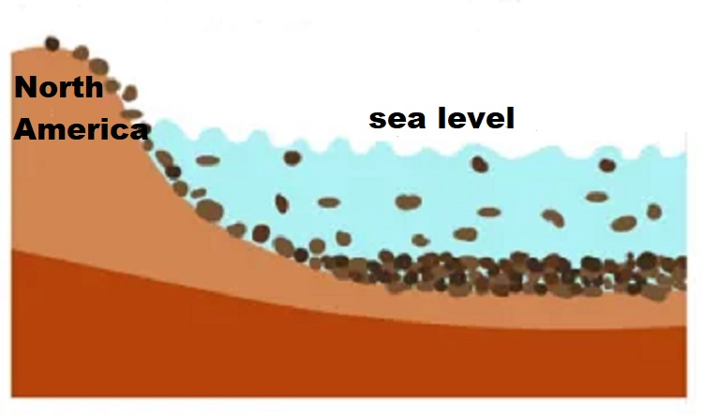
Geological History of NYC
About 400 million years the Eastern boundary of America was a passive margin where a thick sedimentary was developing piling up layers upon layers of rocks.

Slide 3
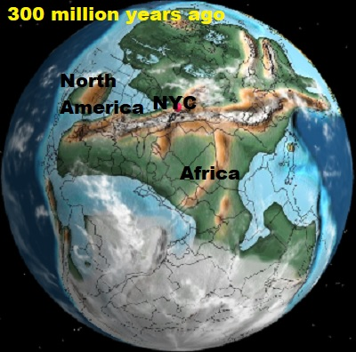
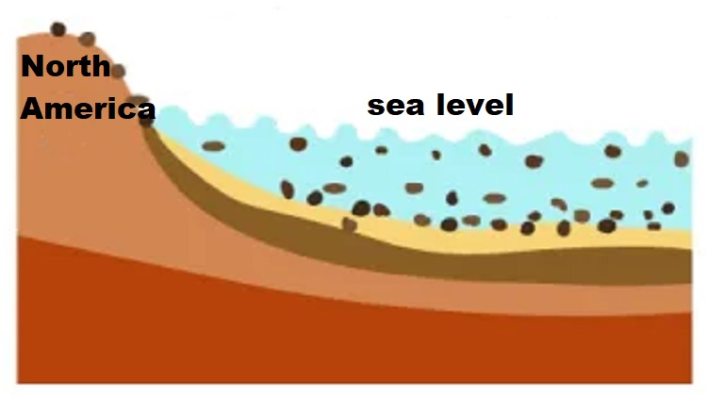
Geological History of NYC
For more than 100 million years ago to about 300 million years ago, this shallow sea floor of the coast of the American continent kept acquiring a thick sedimentary sequence from eroded rocks from the American plate.

Slide 4
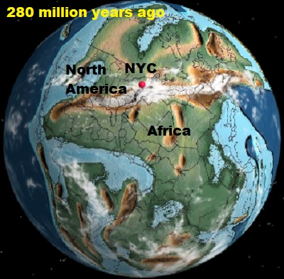
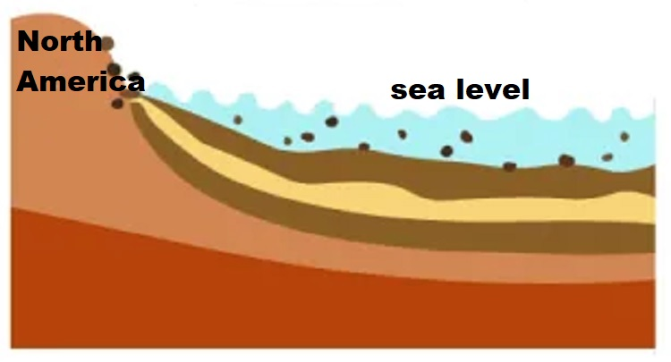
Geological History of NYC
These layers of sediments will later become layers of sedimentary rocks.

Slide 5
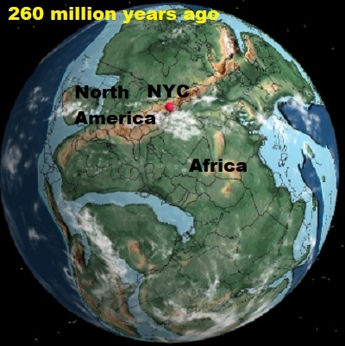
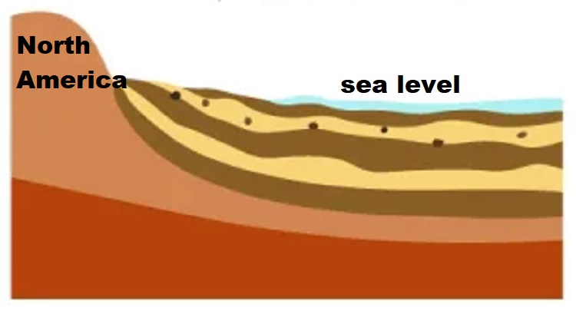
Geological History of NYC
These thick sequence of sediments will reworked and later it will form what are today the rocks of NYC.

Slide 6
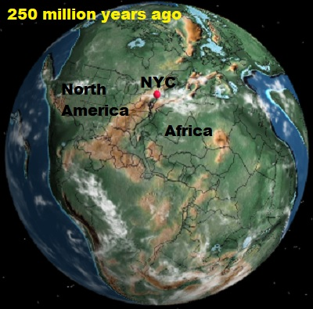
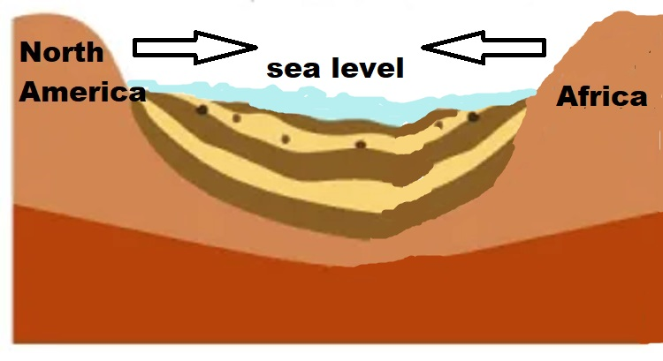
Geological History of NYC
About 250 million years ago the continent of Africa and America started to move towards each other.

Slide 7
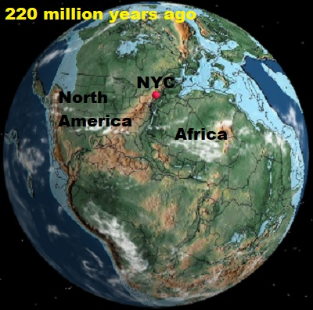
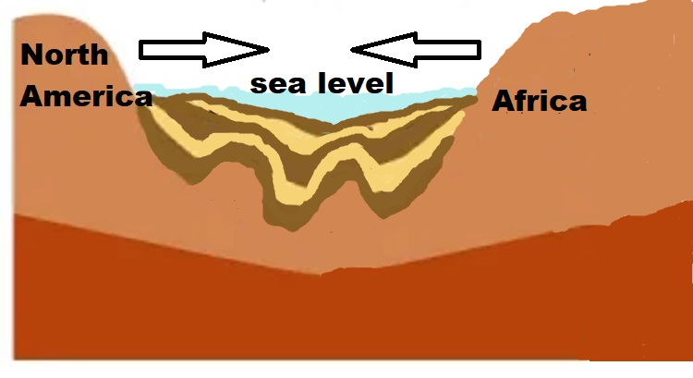
Geological History of NYC
The supercontinent of Pangea started to form. Pangea is the name supercontinent in which all the continents were arranged together as one continent.

Slide 8
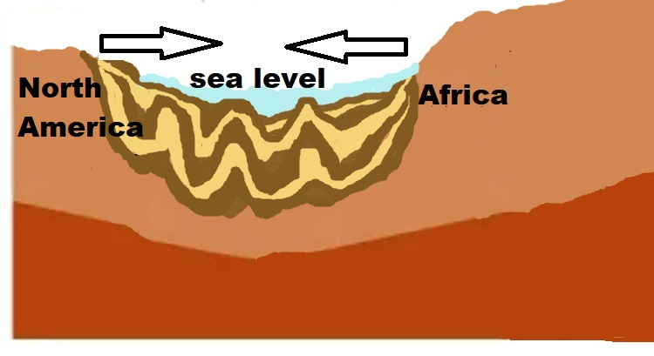
Geological History of NYC
This collision also metamorphosed the sedimentary layers converting these sedimentary rocks into metamorphic rocks.

Slide 9
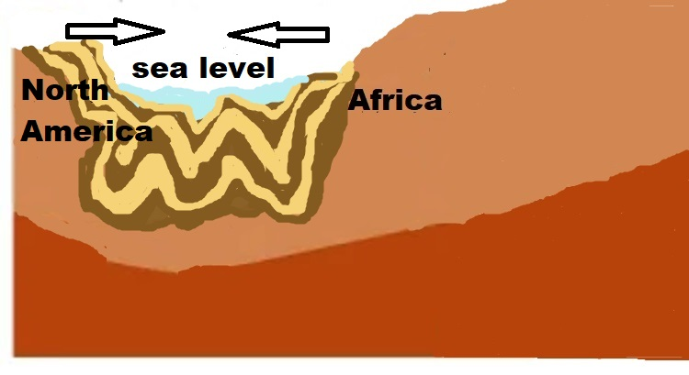
Geological History of NYC
At about 225 million years ago the collision was almost complete deforming and folding the sedimentary layers into highly contorted metamorphic layers.

Slide 10
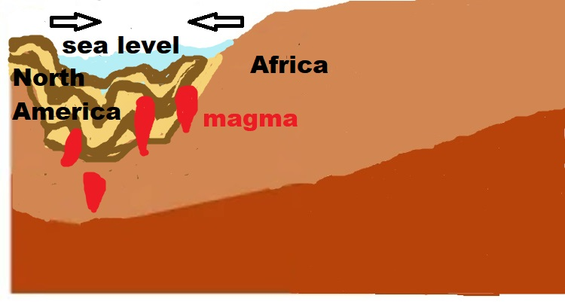
Geological History of NYC
As the collision continued blobs of magmatic intrusions started to mix with the metamorphosed rocks.

Slide 11
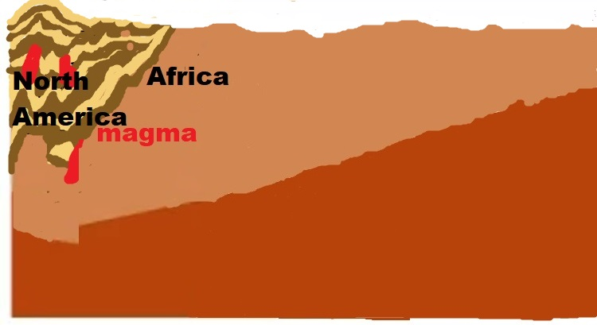
Geological History of NYC
The mountains that were formed by this collision were as tall as the Himalayas mountains.

Slide 12
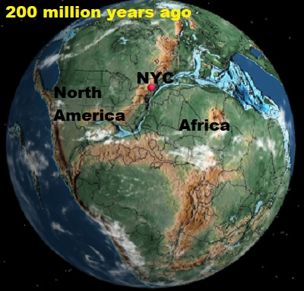
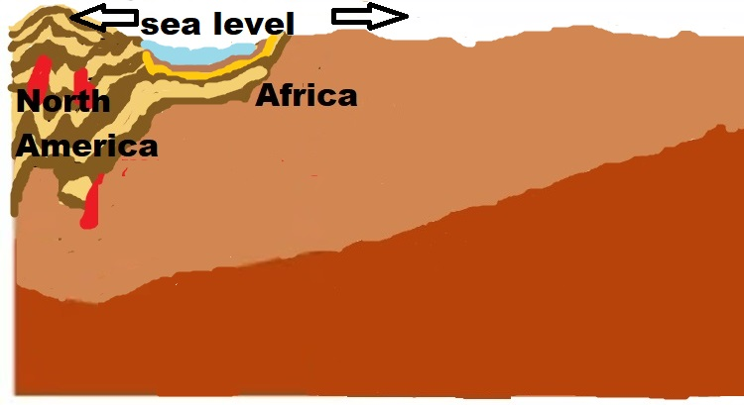
Geological History of NYC
About 200 million years ago and during the 165 million years of dinosaur existence this supercontinent slowly broke apart.

Slide 13
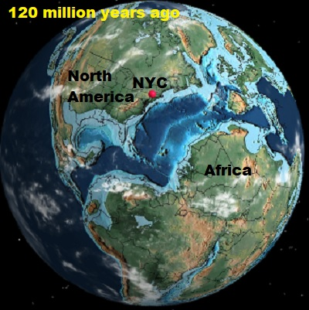
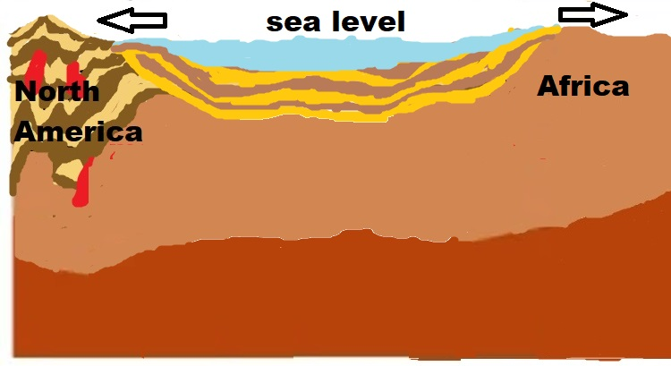
Geological History of NYC
The tall mountains started to erode away. New sedimentary layers started to accumulate in what today is the Atlantic Ocean.

Slide 14
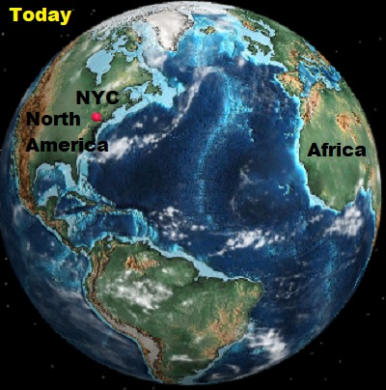
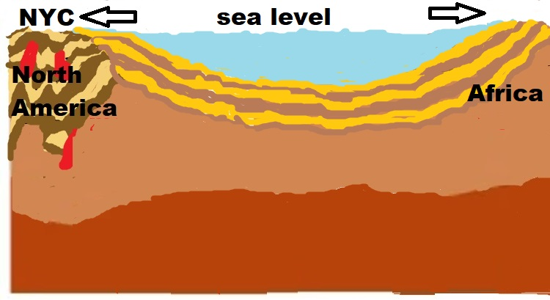
Geological History of NYC
The roots of the tall eroded mountains will later be the bedrock of NYC. Africa and America keep moving away from each other to this date.

Slide 15
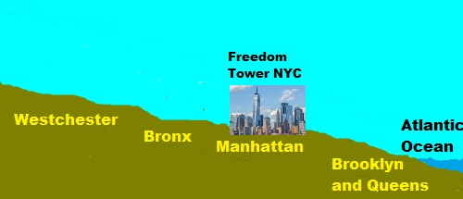
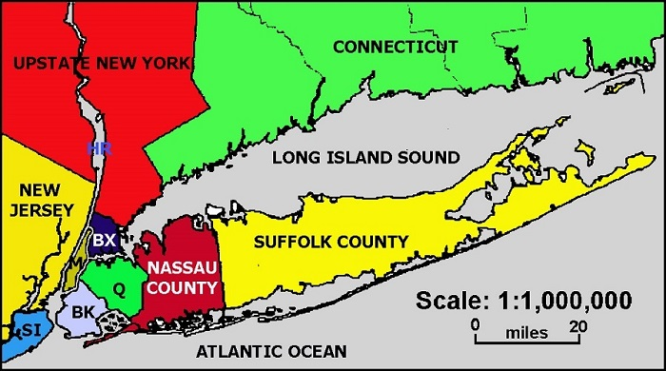
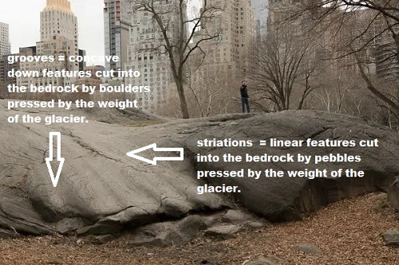
Geological History of NYC
The Wisconsin Ice Sheet, the last of many glacial advances that started at about 90,000 years ago and which stretched down from eastern Canada and advanced as far south as New York City.

Slide 16
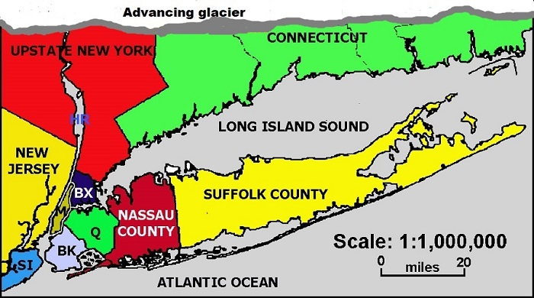
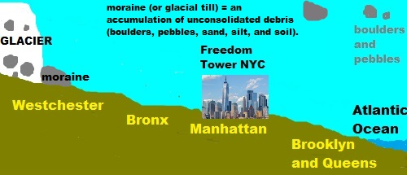
Geological History of NYC
These glaciers left their marks on the city, depositing rock and debris and accounting for the hilly areas that run straight in the northern part of Brooklyn, Queens, Nassau and Suffolk forming the Ronkonkoma Moraine.

Slide 17
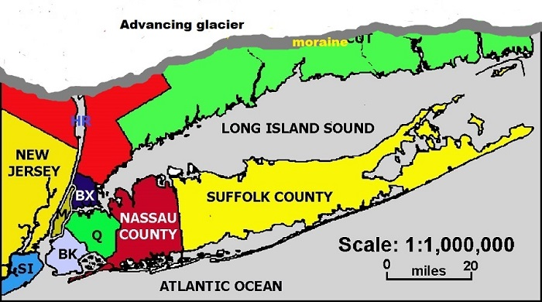
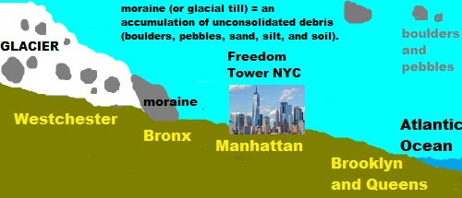
Geological History of NYC
During a period of warmth and retreat the glaciers finally begin their final retreat at about 18,000 years ago.

Slide 18
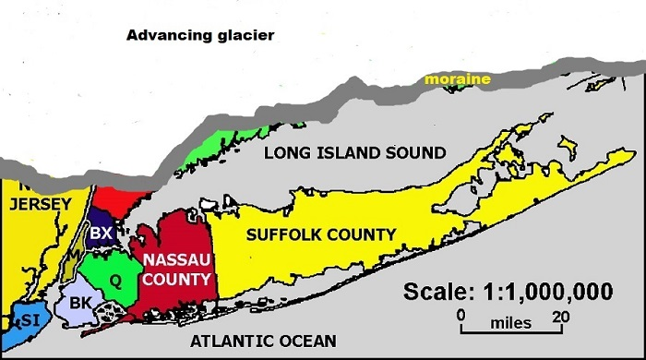
Geological History of NYC
In New York City, the Wisconsin Ice Sheet was about 2,000 feet thick (in the Adirondacks it was over 5,000 feet thick and perhaps as much as 10,000 feet thick in Labrador).

Slide 19
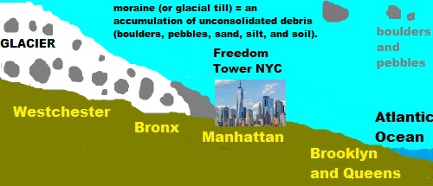
Geological History of NYC
The glacier left boulders in the 5 boroughs of New York City. Angular boulders usually did not travel long distances, whereas rounded boulders travelled long distances and they were constantly being reworked.

Slide 20
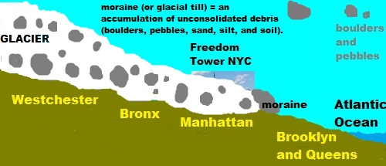
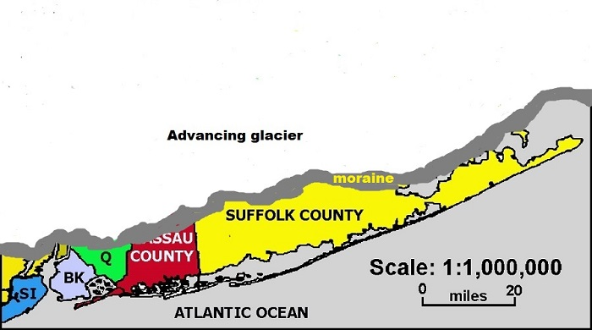
Geological History of NYC
The glacier also left clear markings on the bedrock by cutting it. Grooves are concave down features cut by boulders pressed by the weight of glacier against the bedrock. Striations are linear features cut by pebbles.

Slide 21
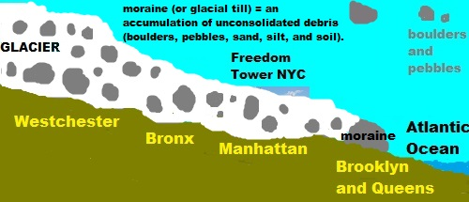
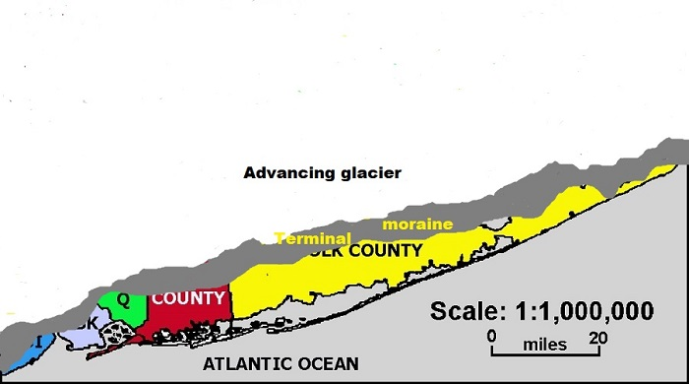
Geological History of NYC
Once the glacier advance stopped a terminal moraine was pushed all the way to what today are the highest places in Staten Island, Brooklyn, Queens, and Long Island.

Slide 22
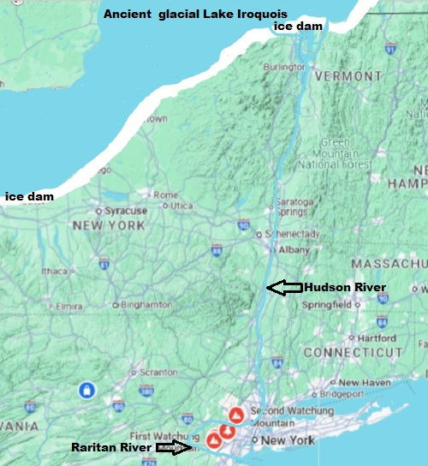
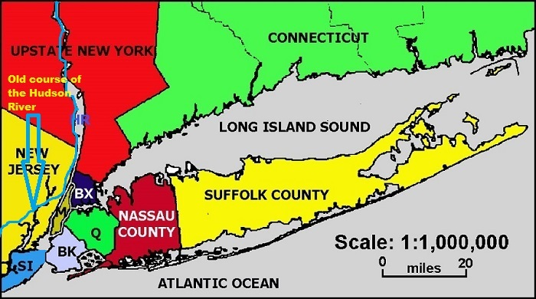
Geological History of NYC
The Narrows was most likely formed after deposition of the Harbor Hill Moraine about 18,000 years prior to the end of the last ice age.

Slide 23
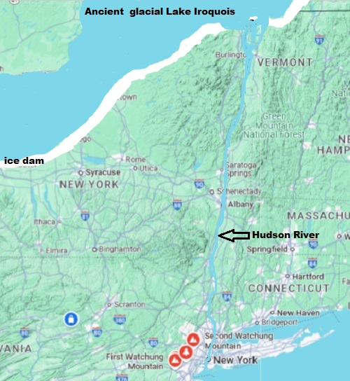
Geological History of NYC
Previously, Staten Island and Brooklyn were connected and the Hudson River emptied into the Atlantic Ocean through the Raritan River.

Slide 24
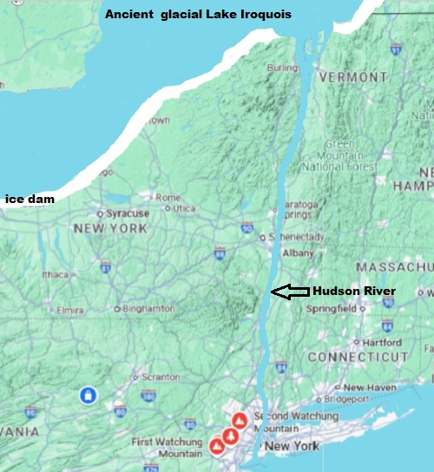
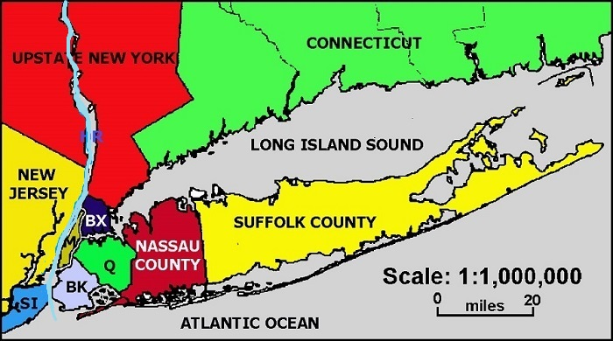
Geological History of NYC
The Hudson took a more westerly course through parts of present-day northern New Jersey, along the eastern side of the Watchung Mountains to Bound Brook, New Jersey via Raritan Bay.

Slide 25
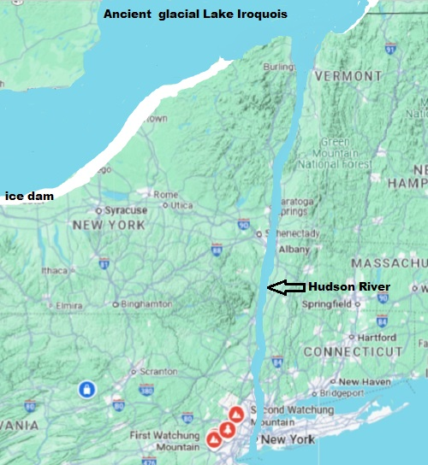
Geological History of NYC
A build-up of water in the Upper Bay allowed the river to break through to form The Narrows less than 12,000 to 13,000 years ago as it exists today.

Slide 26
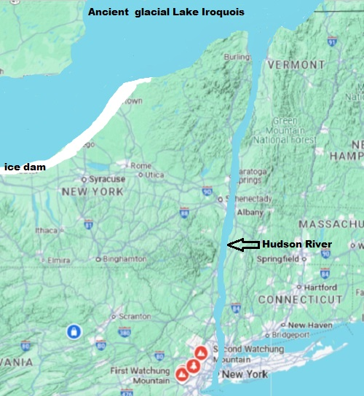
Geological History of NYC
Trapped behind the Adirondack Mountains and a tremendous ice sheet, glacial Lake Iroquois was three times the size of modern Lake Ontario. Then, 13,350 years ago, the natural ice dam collapsed.

Slide 27
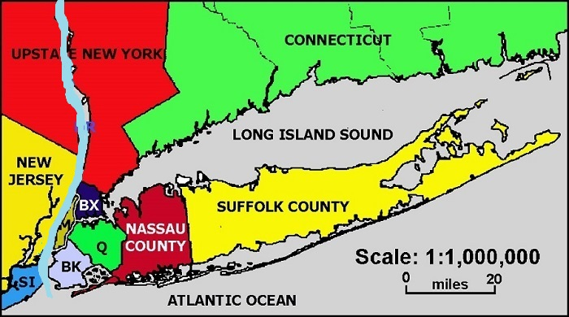
Geological History of NYC
Floodwaters rushed down the Hudson River Valley; past modern Manhattan, Brooklyn, and Staten Island; through an earthen dam where the Verrazanno-Narrows Bridge now stands.

Slide 28
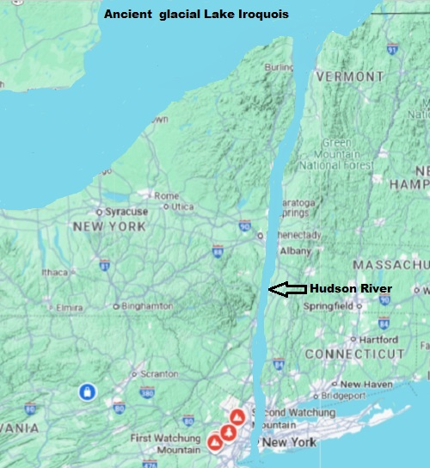
Geological History of NYC
The water level in Lake Iroquois dropped 120 meters (400 feet), and rocks the size of Volkswagens moved hundreds of miles downstream.

