Slide 1
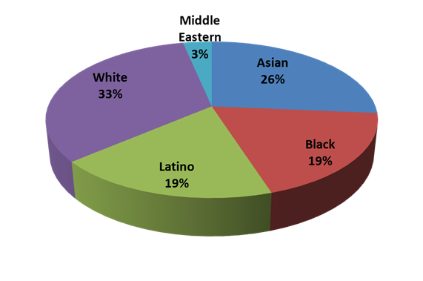
Freshman Health Initiative Survey: A Pilot Study
Roseanne Schnoll, PhD, RD, CDN, Robert Curran, DC, Steven Burroughs, BA
Department of Health and Nutrition Sciences
Brooklyn College of CUNY, Brooklyn, NY 11210
Abstract
Results
Fruit and Vegetable Consumption: Perceived and Actual intake
Vitamin C intake, grouped by age and gender, compared with daily recommended intakes (DRIs)
Nine hundred and seventy-seven entering freshman were emailed surveys about their health, physical activity, and food intake. One hundred and thirty students completed the survey and 80 students completed a 24 hour dietary recall. Fifty percent of respondents felt that they did not meet their nutritional requirements. Sixty-seven percent of the respondents consumed 2 servings or less of vegetables a day, and 80% consumed 2 servings or less of fruits a day. The 24 hour recall showed significant deficiencies in calcium, iron and fiber intake. Sixty-three percent engaged in vigorous exercise less than 3X week and 52% did not engage in any strength training exercises at all. Seventy–nine percent of respondents felt that “lack of time” prevented them from meeting their activity goals and 47% felt that “lack of time” prevented them from meeting nutritional requirements, however, 47% of respondents report spending 16 hours or more per week on the Internet. Future goals include obtaining physical and biochemical data to identify students at risk and implement strategies to target our students’ health and wellness needs.
Reported body mass index
Fifty percent of students felt that they were not meeting their recommended nutritional requirements. Reasons included:
All values expressed in milligrams
Dietary fiber intake, grouped by age and gender, compared with DRIs
Introduction
Numerous colleges distribute surveys regarding health and health habits of college-age students, however, little is known about the dietary practices, health beliefs, physical activity, and weight status of this population. The Freshman Health Initiative aims to be the first study of its kind to take a comprehensive approach in assessing the health and health behaviors of incoming freshman at an urban, underserved commuter college targeting students from very culturally diverse backgrounds.
Activity
24.8% describe their level of activity as being moderately active, 10%
very active.
63% engage in vigorous exercise for at least 20 minutes less than 3X
week.
52% do not engage in any strength training exercises at all.
71.3% do not feel they are meeting their activity goals.
47% spend 16 hours or more per week on the Internet.
79% feels that “lack of time” prevents them from meeting activity goals.
Nutrient intakes were analyzed using ESHA research Food Processor and values were compared to Dietary Reference Intake (DRI) guidelines. Few students met their recommended levels for iron, calcium, vitamin C and fiber.
All values expressed in grams
Methods
Daily iron intake, grouped by age and gender, compared with DRIs
Conclusion
An in-depth questionnaire approved by the Brooklyn College Institutional Review Board was administered to incoming freshmen in August 2009. The 130 item questionnaire covered topics including health status, physical activity, and dietary habits. The survey was administered using Survey Monkey, an on-line survey tool. Incoming freshman were emailed at the beginning of the semester and asked to complete the on-line survey. Data from individual questionnaires was analyzed using SPSS (version 17, SPSS Inc, Chicago, IL). The survey also includes a one-day diet diary. The food diary was analyzed using Food Processor 9.0 (ESHA Research, Salem, OR).
This preliminary data has identified several critical health needs of incoming freshmen to the Brooklyn College community. Based on students’ reported intakes, the majority are not meeting nutrient and physical activity recommendations increasing their risk for chronic disease. Future goals will be to design and implement strategies to combat obesity, inactivity and undernutrition in our student body.
Stress
38% of freshman feel moderately high to high level of stress.
38% of freshman get less than 6 hours of sleep per night.
56% of freshman report that on a typical day they do not wake
completely rested.
Diet
34% of students eat breakfast 6 or more times per week.
52% do not know how many calories they consume a day.
31.5% describe their eating habits as being below average.
50% feel that they are meeting their nutritional requirements.
22% are taking a nutritional supplements which include multivitamins,
calcium and iron.
48% would be interested in enrolling in an undergraduate nutrition
course.
If a college based dietitian/nutritionist was available on campus 64%
would be interested in having a consultation.
32.8 % of freshmen describe themselves as being overweight, but 58%
reported trying to lose weight.
67% of students are eating 2 servings or less of vegetables a day, and
80% are eating 2 servings or less of fruits a day.
Future Goals
Demographics
The Brooklyn College Freshman Health Initiative is the first step in a comprehensive assessment of the health of CUNY students, and the first to objectively assess the health status of students from a diverse, urban commuter college.
Based on this pilot, we have been awarded a PSC-CUNY grant to be continued for fall 2010 freshmen. In addition to administering a survey, physical and biochemical data will be obtained. Height, weight, BMI, body fat percentage, waist to hip ratio and blood pressure, fasting blood glucose, HgA1c and blood lipid levels will be measured.
We will distribute pedometers to students to measure activity levels.
This data can be used to develop and implement strategies to target our students’ health and wellness needs.
All values expressed in milligrams
Calcium intake, grouped by age and gender, compared with daily recommended intakes (DRIs)
One hundred and thirty students completed the survey
Fruit intake: Only 20% of students consume 3 or more servings of fruit a day, but when asked if they thought they were getting their recommended servings of fruits per day, 40% said yes.
Vegetable intake: Only 32.7% of students consume 3 or more servings of vegetables a day, but when asked if they thought they were getting their recommended servings of vegetables per day, 44% said yes.
All values expressed in milligrams

