Slide 1
Psychology 3510: Learning Lecture 1
Fall, 2018
Professor Delamater

Slide 2
Associative Learning
Pavlovian Conditioning (Pavlov)
Instrumental (Operant) Conditioning (e.g.,Thorndike, Skinner)

Slide 3
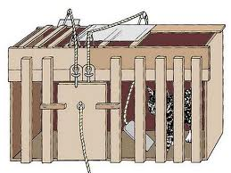
Associative Learning
Pavlovian Conditioning (Pavlov)
Instrumental (Operant) Conditioning (e.g.,Thorndike, Skinner)

Slide 4
Associative Learning
Pavlovian Conditioning
Metronome – Meat Powder
Salivation
The Metronome is temporally paired with meat powder. Initially, the Metronome
does not produce any responses on its own, but the meat powder unconditionally
produces salivation.

Slide 5
Associative Learning
Pavlovian Conditioning
Metronome – Meat Powder CS – US
Salivation Salivation CR UR
After a number of pairings, however, the Metronome acquires the ability to produce a new conditioned response – salivation.
The Metronome is called the conditioned stimulus (CS), the Meat Powder the unconditioned stimulus (US), salivation when it is produced by the Meat powder the unconditioned response (UR), and the salivation when it is produced by the Metronome the conditioned response (CR).

Slide 6
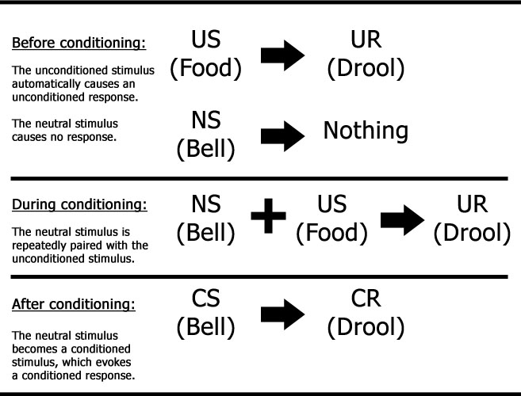
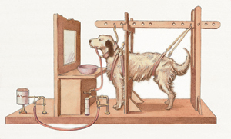
Associative Learning
Pavlovian Conditioning:

Slide 7
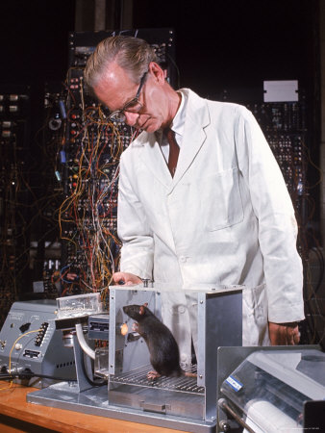
Associative Learning
Instrumental Conditioning (Thorndike, Skinner, others):

Slide 8
Associative Learning
Pavlovian vs Instrumental Conditioning:
CS - US Contingency
R - Reinforcer Contingency
The main procedural difference between Pavlovian and instrumental
conditioning is that in Pavlovian learning the critical environmental contingency
is that between two stimuli (CS and US), whereas in instrumental conditioning
the critical environmental contingency is that between the animals own response
and the events that follow (for instance, the reinforcing event). Note that the “US” and
the “reinforcer” can both be the same event, e.g., food.

Slide 9
Rationale for Studying Associative Learning in Non-Human Animals
Associative learning: an important psychological process
Evolution of Intelligence
Neurobiological study of learning is easier
Causal factors are more easily revealed (through experimental control)
Simple systems approach
Animal models can lead to benefits for humans
(e.g., drug discovery, brain mechanisms of psychopathology, etc)

Slide 10
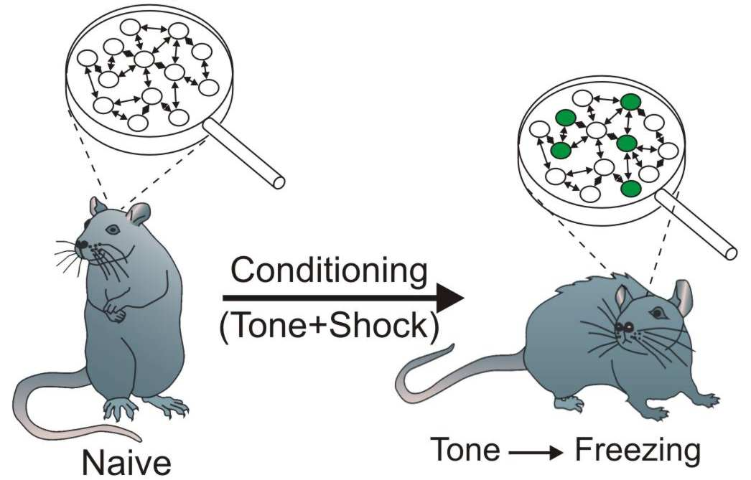
Some Basic Assumptions
Learning: Defined as an experience-dependent change in the
mechanisms underlying behavior.
- Learning/Performance distinction
- Learning versus Fatigue, Maturation

Slide 11
Some Basic Assumptions
Learning: Defined as an experience-dependent change in the
mechanisms underlying behavior.
- Learning/Performance distinction
- Learning versus Fatigue, Maturation
Levels of Analysis
- Individual neuron and synaptic level (molecular/genetic mechanisms)
- Neural networks (brain structure interactions and neurochemistry)
- Whole organism (Behavior)
General Process Approach
- Recognize behavioral diversity, but search for general laws
- Experimental control (lab versus naturalistic observation methods)

