Slide 1
Lecture 11: Pavlovian Conditioning (Associative Content)
Learning, Psychology 3510
Fall, 2018
Professor Delamater

Slide 2
Pavlovian Learning
Three Key Questions
1. What are the major determinants of learning?
2. What is the content of learning?
3. How does learning get translated into performance?

Slide 3
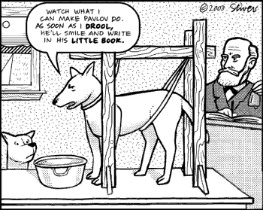
Pavlovian Learning
Three Key Questions
1. What are the major determinants of learning?
2. What is the content of learning?
3. How does learning get translated into performance?

Slide 4
Pavlovian Learning: Different Associative Structures
S-S association
S-R association
Multiple aspects of the US (e.g., sensory, emotional)
Binary vs Hierarchical associations
The discussion of “what is learned” in Pavlovian conditioning has
given rise to a variety of interesting experiments that point to
different ways in which animals can learn about their environment.
Essentially, these studies ask how the animal represents its world as
it learns about relationships among events within it. We’ll
now consider some of these studies...

Slide 5
S-S vs S-R learning
S-S?
Clicker
CS
US
Meat powder
Or S-R?
UR
Salivation
We are asking whether the animal associates the CS with the stimulus properties
of the US or with the response evoked by the US.

Slide 6
Sensory Preconditioning Experiment
Sensory Preconditioning Experiment (Brogden, 1939)
Phase 1 Phase 2 Test
Expt Gp: CS2 - CS1 CS1 - US CS2?
Ctrl Gp: CS2 | CS1
Real world example: Parks – Dogs, Dogs – Bite, Afraid of Parks?

Slide 7
Sensory Preconditioning Experiment
Sensory Preconditioning Experiment (Brogden, 1939)
Phase 1 Phase 2 Test
Expt Gp: Light - Tone Tone - Shock Light?
Ctrl Gp: Light | Tone
Rats responded more to CS2 in the Experimental Group than the Control Group and this suggests that S-S associations can be learned.

Slide 8
Sensory Preconditioning & Second Order Conditioning Compared
Sensory Preconditioning Experiment (Brogden, 1939)
Phase 1 Phase 2 Test
Expt Gp: CS2 - CS1 CS1 - US CS2?
Ctrl Gp: CS2 | CS1
Real world example: Parks – Dogs, Dogs – Bite, Afraid of Parks?
Second Order Conditioning Experiment
Phase 1 Phase 2 Test
Expt Gp: CS1 – US CS2 - CS1 CS2?
Ctrl Gp: CS2 | CS1
Real world example: Dogs – Bite, Park – Dogs, Afraid of Parks?
In Second Order Conditioning, the first 2 phases are reversed.
CS2 is responded to more in the Experimental Group than the Control Group here as well.
SPC suggests that S-S associations can be learned.
In Second Order Conditioning, however, either S-S or S-R associations could be learned.

Slide 9
Pavlovian 1st Order Conditioning: US Devaluation Test
US Devaluation Experiment
Phase 1 Phase 2 Test
Expt Gp: CS – US Devalue US CS?
Ctrl Gp: CS – US Do NOT Devalue US CS?
If S-S association was learned, then US devaluation should diminish CRs to the CS because the CS activates a memory of the US whose value has been reduced.
If S-R association was learned, then US devaluation should have no effect because the CS activates the response itself (NOT a memory of the US). In this case, the altered value of the US should play no role.

Slide 10
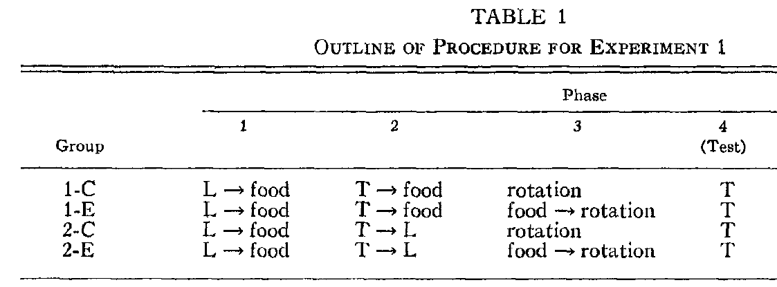
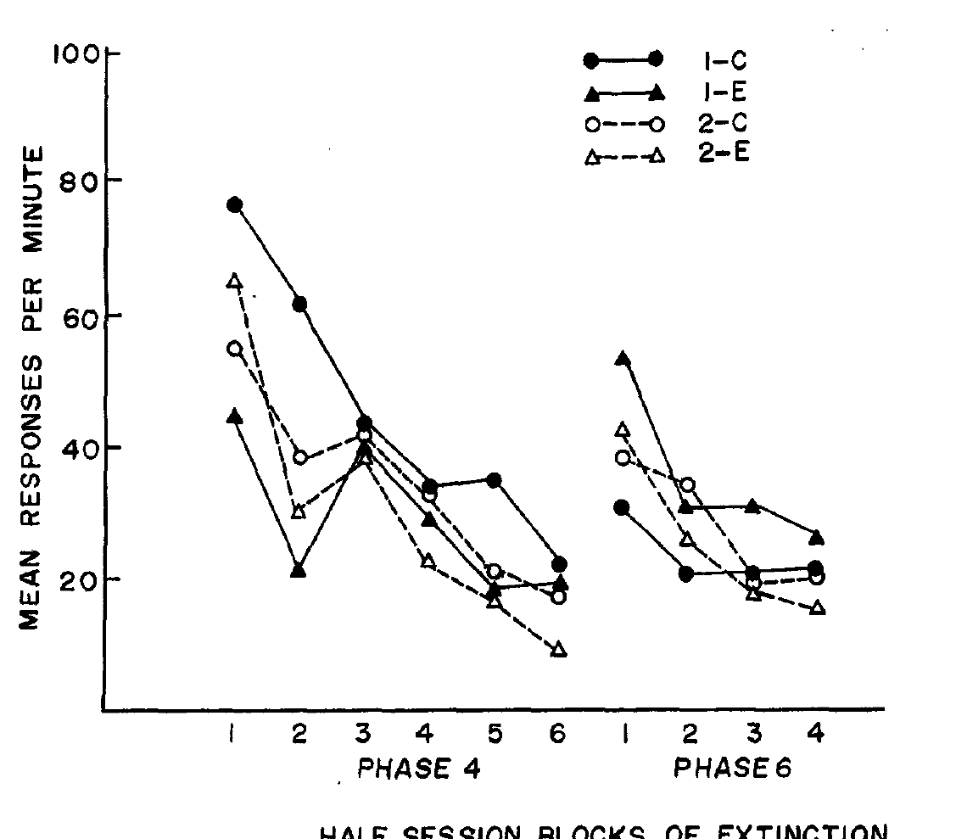
Pavlovian 1st vs 2nd Order Conditioning: US Devaluation Test
US Devaluation Experiment (Holland & Rescorla, 1975)
Appetitive (Food) conditioned activity procedure
with rats.
1st order Tone CRs were reduced in the Group given
food – rotation devaluation training (Group 1-E).
These results show that S-S learning can occur in Pavlovian 1st order conditioning.

Slide 11
Pavlovian 1st vs 2nd Order Conditioning: US Devaluation Test
US Devaluation Experiment (Holland & Rescorla, 1975)
Appetitive (Food) conditioned activity procedure
with rats.
1st order Tone CRs were reduced in the Group given
food – rotation devaluation training (Group 1-E).
These results show that S-S learning can occur in Pavlovian 1st order conditioning.
Second order CRs are completely unaffected by the food devaluation treatment, suggesting that 2nd order CRs are based on S-R associations.

Slide 12
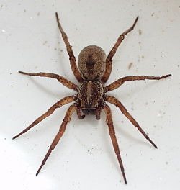
Associations with Multiple US Attributes: Spider Fears Example

Slide 13
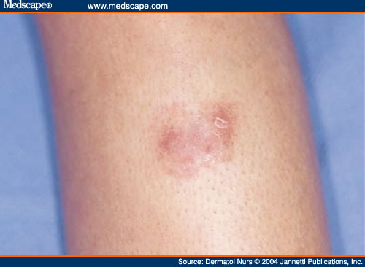
Spider Fears

Slide 14
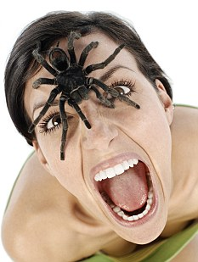
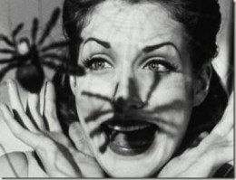
Spider Fears

Slide 15
Spider Fears: Multiple Associations
Bites (sensory)
USS
CS
USE
Fear (emotional)

Slide 16
Spider Fears: Multiple Associations
Bites (sensory)
USS
CS
USE
Fear (emotional)
QUESTION: Can we provide evidence for these two types of associations in Pavlovian learning?

Slide 17
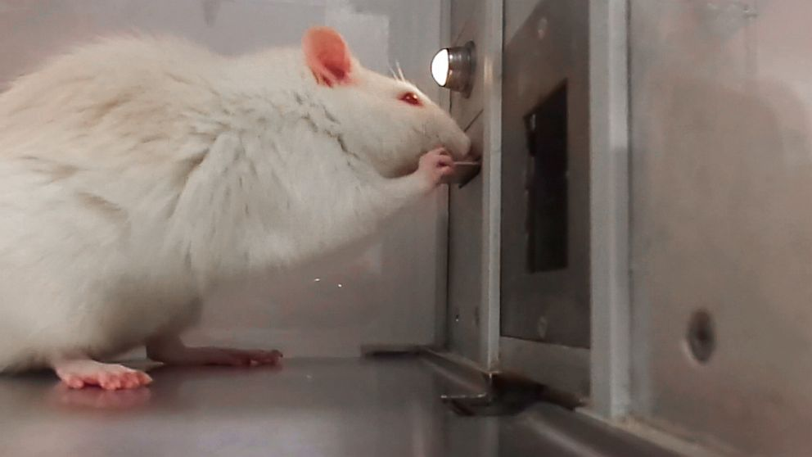
Associations with Multiple US Attributes
Sensory vs Emotional Learning Study: Corbit & Balleine (2005)
All rats were first instrumentally trained to press one lever for one food reward type (O1) and a second lever for a second food reward type (O2). The rewards were food pellets and liquid sucrose.
Then they were given Pavlovian training where one stimulus was paired with O1, a second with O2, and a third CS was paired with O3 (a new liquid outcome different from the others).
Finally, the rats were tested by presenting them with each stimulus while they had a chance to press the different levers (without food rewards).

Slide 18
Associations with Multiple US Attributes
Sensory vs Emotional Learning Study: Corbit & Balleine (2005)
The CSs (S1, S2) increased magazine responses across the conditioning phase.
The CSs (S1, S2) selectively increased the instrumental response when they had both been paired with the Same, but not Different, outcome (food reward type). This indicates that the CSs had associated with the sensory aspects of the US.

Slide 19
Associations with Multiple US Attributes
Sensory vs Emotional Learning Study: Corbit & Balleine (2005)
The CSs (S1, S2) increased magazine responses across the conditioning phase.
The CSs (S1, S2) selectively increased the instrumental response when they had both been paired with the Same, but not Different, outcome (food reward type). This indicates that the CSs had associated with the sensory aspects of the US.
S3 (“General” stimulus) non-selectively energized BOTH instrumental responses. This means that the CS had associated with some general ”motivational” or “emotional” aspect of the US.

Slide 20
Associations with Multiple US Attributes
Sensory vs Emotional Learning Study: Corbit & Balleine (2005)
Finally, different brain regions appear to mediate these two different types of learning.
Animals with basolateral amygdala (BLA) lesions showed the general, but not specific effect.
Animals with central nucleus of the amygdala (CN) lesions showed the specific, but not general effect.
This means that the BLA is important for learning about sensory aspects, while CN is important for learning about the emotional aspects of the US.

Slide 21
Binary vs Hierarchical Associations
Holland, 1985 Study
Positive Occasion Setting Task
Tone – Light – Food (on some conditioning trials)
Light – No Food (on other conditioning trials)
Here, Light leads to the food US only when presented after Tone
but NOT when presented on its own.
Tone could come to “set the occasion” upon which Light is associated with the food US.
In other words, Tone modulates learning about the L – Food pellet relationship.

Slide 22
Binary vs Hierarchical Associations
Occasion Setting vs Simple Discrimination Tasks
Holland 1985
Gp Simultaneous TL – Pellet Head Jerk CRs to TL
L – No Pellet
Gp Serial T - L – Pellet Rear CRs to T - L
L – No Pellet

Slide 23
Binary vs Hierarchical Associations
Occasion Setting vs Simple Discrimination Tasks
Holland 1985
Gp Simultaneous TL – Pellet Head Jerk CRs to TL
L – No Pellet
Gp Serial T - L – Pellet Rear CRs to T - L
L – No Pellet
L
Pel
L
Pel
T
T
Gp Simultaneous (binary associations) Gp Serial (hierarchical association)

