Slide 1
Lectures 14: Instrumental Conditioning (Basic Issues)
Learning, Psychology 3510
Fall, 2017
Professor Delamater

Slide 2
Associative Learning
Pavlovian vs Instrumental Conditioning:
CS - US Contingency
R - Reinforcer Contingency
The main procedural difference between Pavlovian and instrumental
conditioning is that in Pavlovian learning the critical environmental contingency
is that between two stimuli (CS and US), whereas in instrumental conditioning
the critical environmental contingency is that between the animals own response
and the events that follow (for instance, the rewarding US).

Slide 3
Instrumental Learning
Three Key Questions
1. What are the major determinants of learning?
2. What is the content of learning?
3. Motivational factors affecting performance?
Basic Paradigms
4 Basic Instrumental Contingencies
Determining Conditions
Nature of the Response
Nature of the Reinforcer
Response-Reinforcer Relations
Temporal Contiguity, Reinforcer Surprise, Contingency

Slide 4
Instrumental Learning: Basic Paradigms
Discrete Trials vs Free Operant
Puzzle Box (Thorndike), Mazes (Runway, T-Maze, etc)
Operant Conditioning chambers (BF Skinner)
Early approaches used discrete trials tasks. The animal was placed
in the apparatus and removed at the end of the conditioning trial.
Then it was returned for another discrete trial later. In Free operant
tasks, the animal is placed in the apparatus and permitted to
respond freely during the entire conditioning session without
interruption.

Slide 5
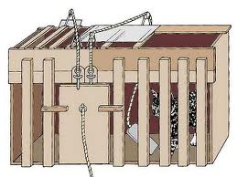
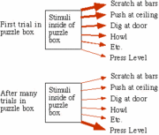
Discrete Trials Approaches
Cats learned to escape puzzle box to obtain food reward.
Thorndike assumed this was caused by the development of an S-R association.
Reinforcement “stamped in” this association, without itself being learned about.

Slide 6
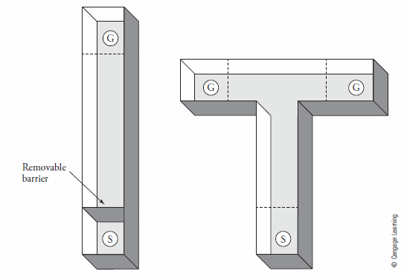
Discrete Trials Approaches
Rats learn to run down the runway (leaving the start box to the goal box) to get food.
They can also learn to choose the correct side in a T maze.
Learning is assessed with running speed in runway, and % Correct choice in T maze.

Slide 7
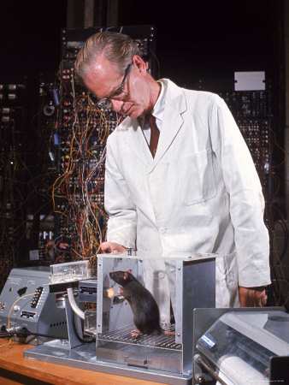
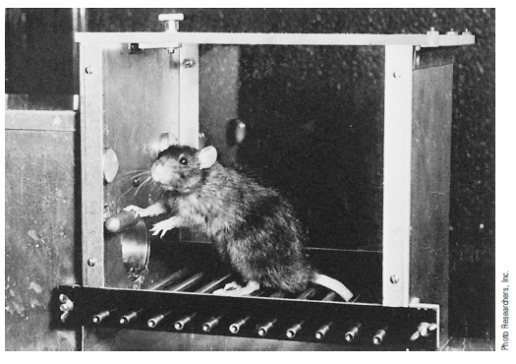
Free Operant Approaches
Rats learn to press a lever to get food, continue responding uninterrupted.
Response rate is one measure of instrumental learning.
The “operant” response is defined as that set of actions that result in delivery of
the reinforcement (namely, pressing the lever in some manner). In this way, responding
and hence, learning, can be easily assessed.

Slide 8
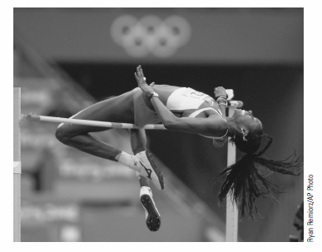
Shaping of Instrumental Responses
Learning a response often consists of shaping by successive approximations.
Reinforcement is given for successively closer approximations to the target response.
These responses may consist of new combinations of existing responses or the learning
of entirely new responses.

Slide 9
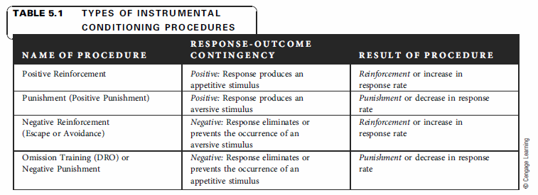
4 Basic Instrumental Contingencies
Response leads to Positive Event (Positive Reinforcement)
Response leads to Negative Event (Punishment)
Response leads to termination or prevention of Negative Event (Negative Reinforcement)
Response leads to termination or prevention of a Positive Event (Omission)
Reinforcement procedures increase responding, the others decrease responding.

Slide 10
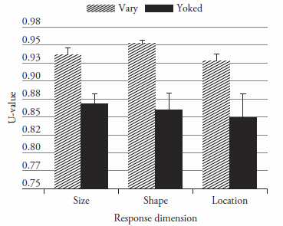
Instrumental Learning: Determining Conditions
1. Nature of the Response (Complex vs Simple Dimensions)
Ross & Neuringer (2002) Study
Some humans were asked to draw
Rectangles to earn points.
In one group only rectangles that
differed from previously drawn ones
were reinforced.
The “yoked” group were given
reinforcements for drawing rectangles
whenever the first group earned reinforcement, but there was no requirement
to draw rectangles in any particular way.
Variable responses can be reinforced and increase in frequency when they are.
Responses tend to be less variable and more consistent when variability is not reinforced.

Slide 11
Instrumental Learning: Determining Conditions
1. Nature of the Response (Response “Belongingness”)
Shettleworth (1975) Study
Hamsters were observed when hungry (food deprived) or not hungry.
Some responses increased when hungry and others did not increase.
Different groups of hamsters could earn food reward when hungry, but
which response was required was varied.
Those responses that also increased under baseline conditions when the
Hamster was hungry were reinforced more easily than the other responses.
This indicates that some responses-reinforcer relations are better learned about
than others.
Remember the CS-US relevance effect in Pavlovian learning (Garcia & Koelling, 1966)???
Maybe those responses that are “relevant” to the particular behavior system being tapped into are most easily reinforced.

Slide 12
Instrumental Learning: Determining Conditions
1. Nature of the Response (Response “Belongingness”)
Breland and Breland (1961) “Miserly Raccoon” Study
Raccoons asked to deposit coins (1 or 2) in a piggy bank.
They had a hard time doing this, instead they kept ahold of the coin
and treated it as a food object (licking it, biting it, etc).
This is called “Instinctive Drift” and reflects the intrusion of Pavlovian CRs
that can compete with learning the instrumental task. In this case, the coin acts as a Pavlovian CS that gets associated with food as the US. The CR interferes with the production of the instrumental response (carrying the coin to the piggy bank and dropping it through the slot).

Slide 13
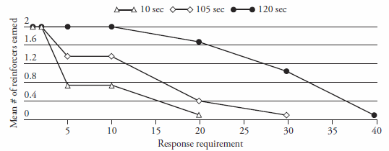
Instrumental Learning: Determining Conditions
2. Nature of the Reinforcer (Reward Magnitude)
The larger the reward, the better the reinforcing effect
Trosclair-Lasserre et al. (2008) Autism Study
Child had to press a button in order to obtain a social attention reward (tickles, praise,etc)
Greater “Progressive Ratio” responding with longer duration rewards.

Slide 14
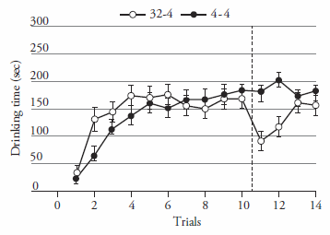
Instrumental Learning: Determining Conditions
2. Nature of the Reinforcer (Perceived Reward Magnitude)
Behavioral Contrast Effects (e.g., Negative Contrast)
Ortega et al. (2011) Study
A small reward is rated as less valuable when the animal has prior experience with
a larger reward.
Shows up here as a decrease in drinking 4% sucrose after the rat had earlier consumed 32%.

Slide 15
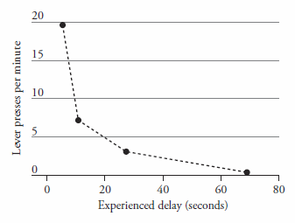
Instrumental Learning: Determining Conditions
3. Nature of the Response-Reinforcer Relationship (Contiguity)
Temporal Contiguity (between Response and Reward)
Dickinson, Watt, & Griffiths (1992) Study
Rats lever press more when food reward is given soon after the response
Lever press responding decreases as the R-Reward contiguity is reduced
This clearly shows that temporal contiguity is important for instrumental learning.

Slide 16
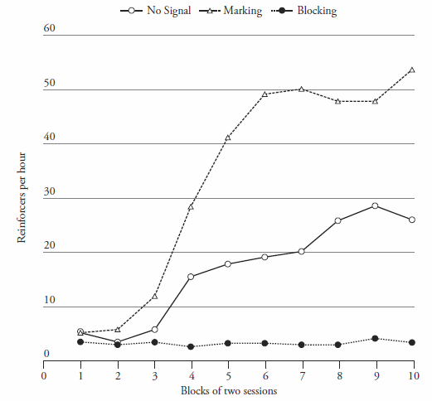
Instrumental Learning: Determining Conditions
3. Nature of the Response-Reinforcer Relationship (Reward Surprise)
Reward Surprise
Williams (1999) Study
Rats lever press with a 30-s R-Reward interval
A 5-s Light occurs either just after the Response, just before the reward, or not at all.
A No Light group acquires responding, but the
Late Light group does not, and the Early Light
group acquires responding best of all.
The Light acts as a conditioned reinforcer
(or “marking” stimulus) if it occurs just after the
Response, but it Blocks instrumental learning if
it occurs just before the reward.
This blocking effect occurs because the Light
Predicts the food reward and renders it unsurprising. This interferes with instrumental learning.

Slide 17
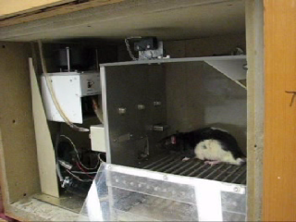
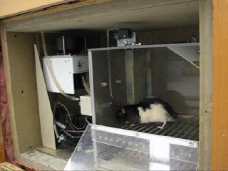
Instrumental Learning: Determining Conditions
3. Nature of the Response-Reinforcer Relationship (Contingency)
Contingency (between Response and Outcome) or Temporal Contiguity?
Instrumental Contingency Experiment (Colwill & Rescorla, 1986)
Research Question: Does contingency or contiguity determine instrumental learning?
Experimental Design
Lever Press -> Pellets
Chain Pull -> Sucrose
(Freely Delivered) Pellets

Slide 18
Instrumental Learning: Determining Conditions
3. Nature of the Response-Reinforcer Relationship (Contingency)
Contingency (between Response and Outcome) or Temporal Contiguity?
Instrumental Contingency Experiment (Colwill & Rescorla, 1986)
Research Question: Does contingency or contiguity determine instrumental learning?
Experimental Design
Lever Press -> Pellets
Chain Pull -> Sucrose
(Freely Delivered) Pellets
Hypothesis:
If its Contiguity, then both responses should be =
But, if its Contingency, then notice that the Chain-Sucrose
Contingency is stronger than the Lever-Pellet contingency.
So, Chain Pull should be > than Lever Press

Slide 19
Instrumental Learning: Determining Conditions
3. Nature of the Response-Reinforcer Relationship (Contingency)
Contingency (between Response and Outcome) or Temporal Contiguity?
Instrumental Contingency Experiment (Colwill & Rescorla, 1986)
Research Question: Does contingency or contiguity determine instrumental learning?
Results:
The Rats Chain Pull Responses > Lever Press
This confirms that Contingency is important during Instrumental learning, much like it has been shown in
Pavlovian learning.
Experimental Design
Lever Press -> Pellets
Chain Pull -> Sucrose
(Freely Delivered) Pellets

