Slide 1
Lecture 2: Historical and Philosophical Roots
Learning, Psychology 3510
Fall, 2018
Professor Delamater

Slide 2
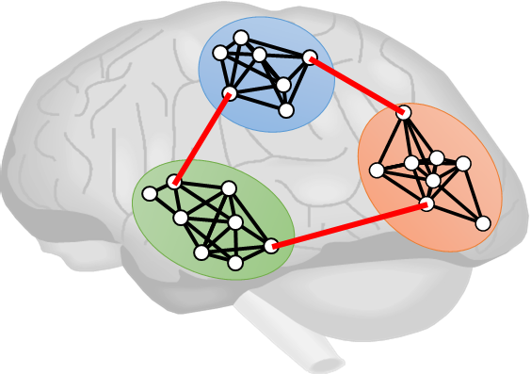
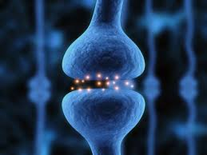
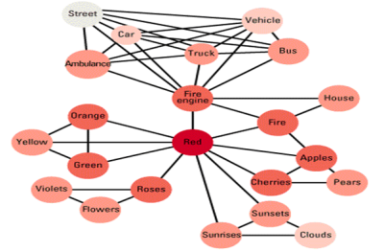
Associative Learning: 3 Influences
3 Intellectual Traditions
Philosophy of Mind
Russian Physiology
Evolutionary Theory

Slide 3
Philosophy of Mind
Descartes
British Empiricists (e.g., Hobbes, Hume, Locke)
Rationalists (e.g., Kant)

Slide 4
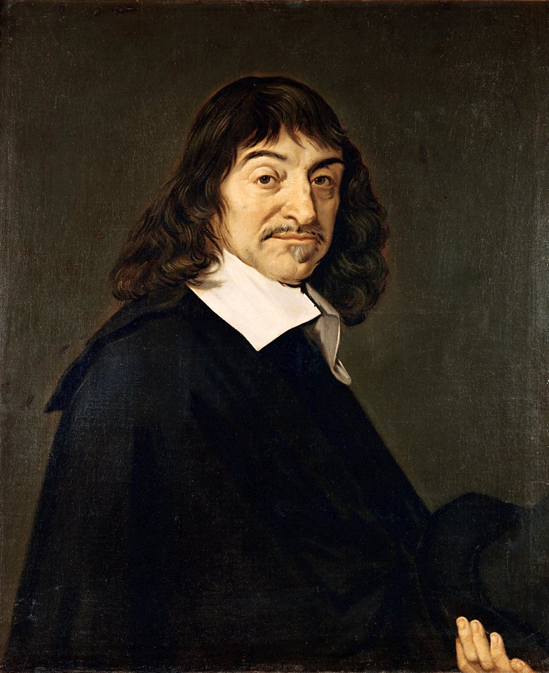
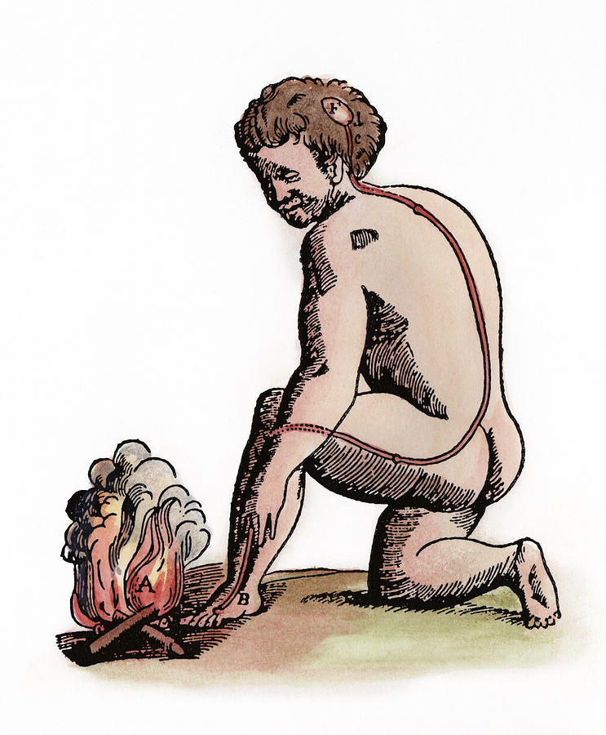
Philosophy of Mind
Descartes
1. Mind/Body Dualism
a. Non-physical | Physical
b. Voluntary | Involuntary Behavior
c. Human | Animal Minds
d. No Laws controlling Mind| Involuntary behavior is lawful
e. No mechanisms of mind | Reflex is basic mechanism of invol beh

Slide 5
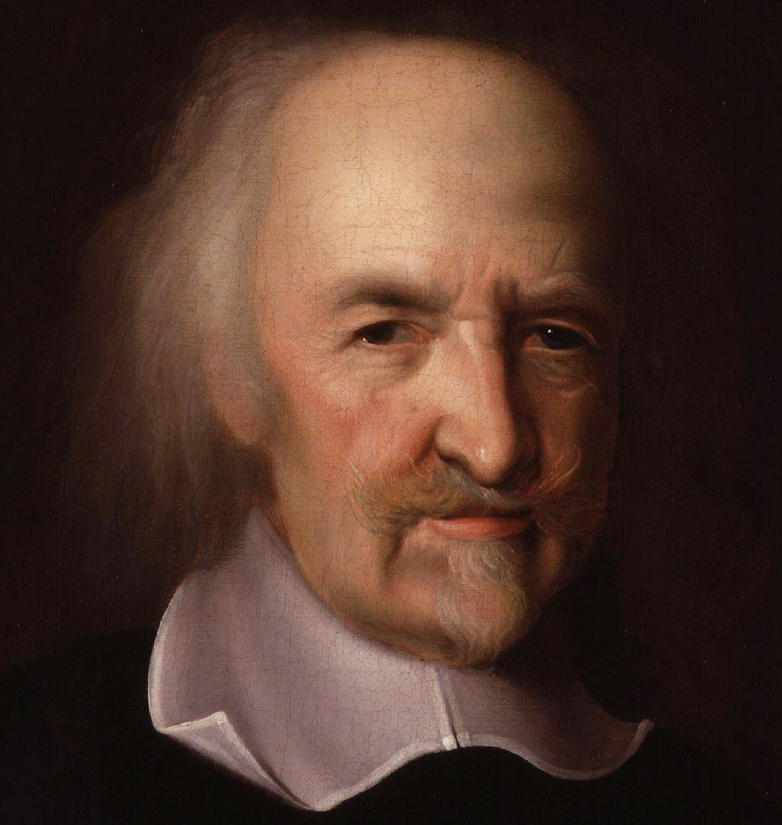
Philosophy of Mind
British Empiricists
1. Offered mechanistic explanation for mind
a. Hobbes: Law of hedonism

Slide 6
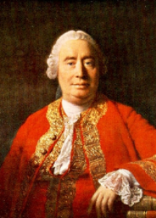
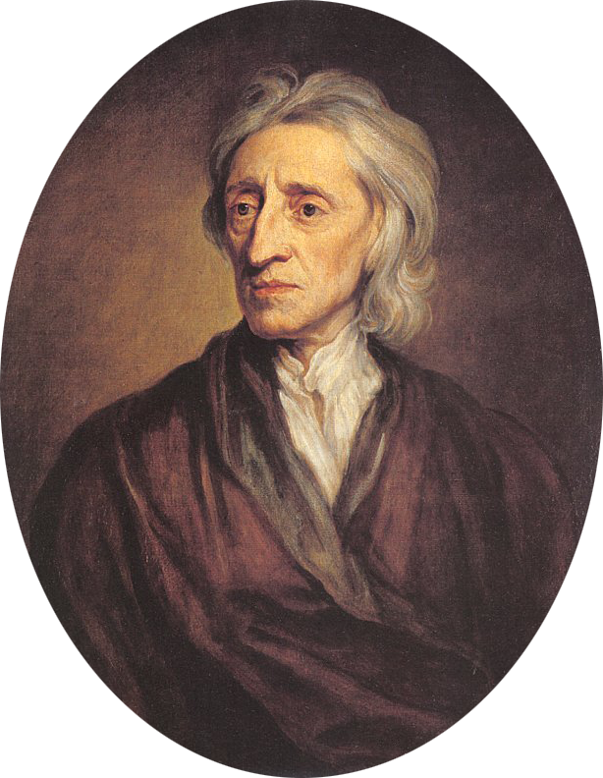
Philosophy of Mind
British Empiricists
1. Offered mechanistic explanation for mind
a. Hobbes: Law of hedonism
b. Hume, Locke: tabula rasa idea
- Empiricism
- Elementalism
- Associationism (e.g., Law of Temporal Contiguity)

Slide 7
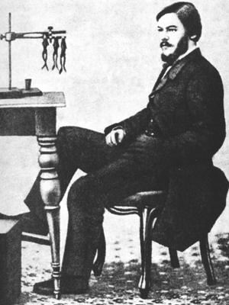
Russian Physiologists
Sechenov
All behavior controlled by stimulus antecedents
Inhibitory Reflex (to help explain voluntary behavior)
Reflex acted as a trigger, not energy reflected (as Descartes imagined)

Slide 8
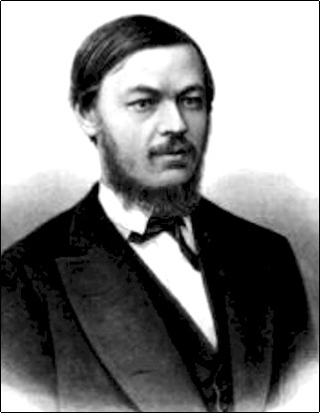
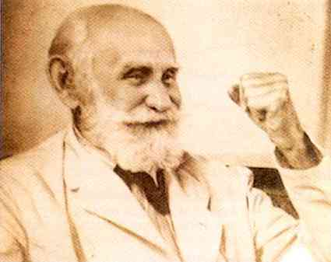
Russian Physiologists
Sechenov
All behavior controlled by stimulus antecedents
Inhibitory Reflex (to help explain voluntary behavior)
Reflex acted as a trigger, not energy reflected (as Descartes imagined)
Pavlov
Developed a method (a paradigm) to study learning & brain
This method could be used to study empirical laws
Excitatory & Inhibitory Unconditioned & Conditioned reflexes control behavior

Slide 9
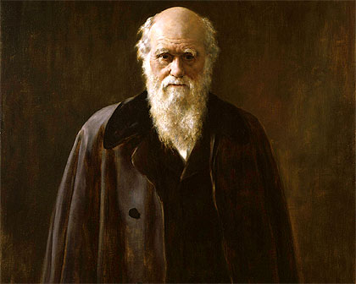
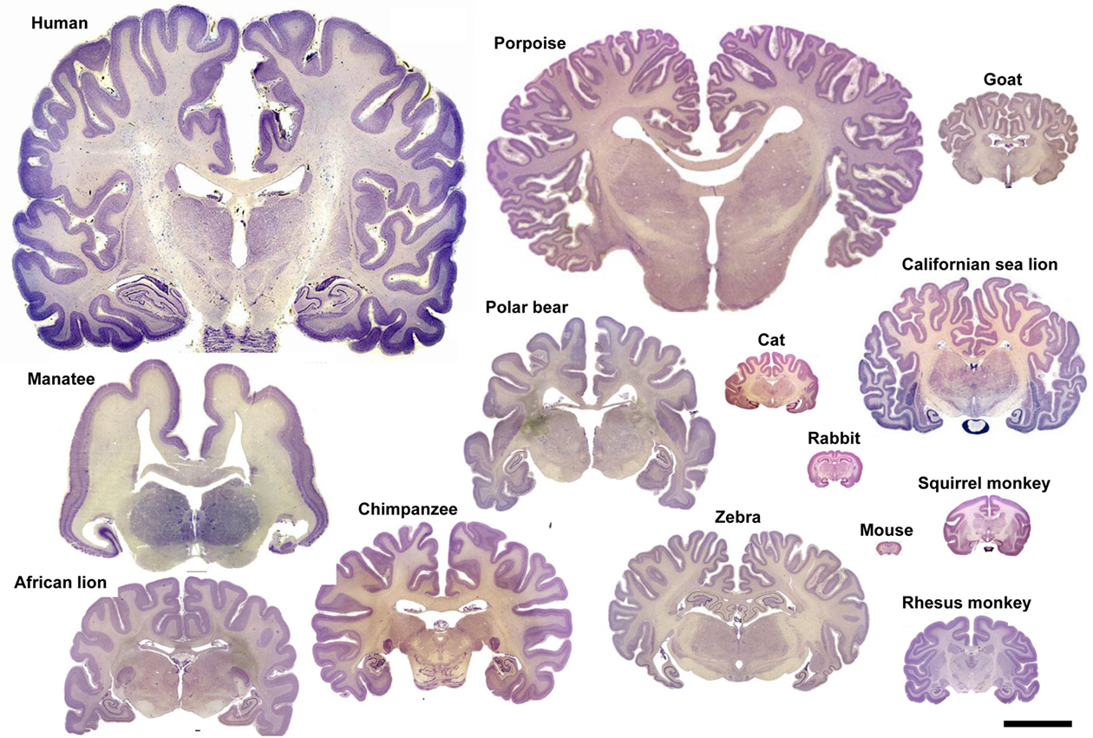
Evolutionary Theory
Darwin
Mental Continuity among species (justifies search for general laws of behavior)
Species diversity (there may be differences as well)
Lots of similarities in brains across species, perhaps there are similarities
in mental characteristics as well.

Slide 10
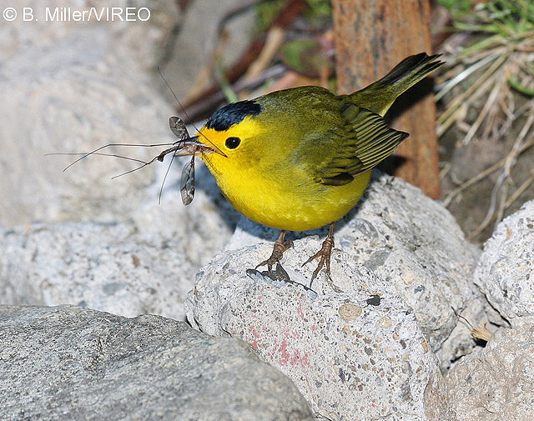
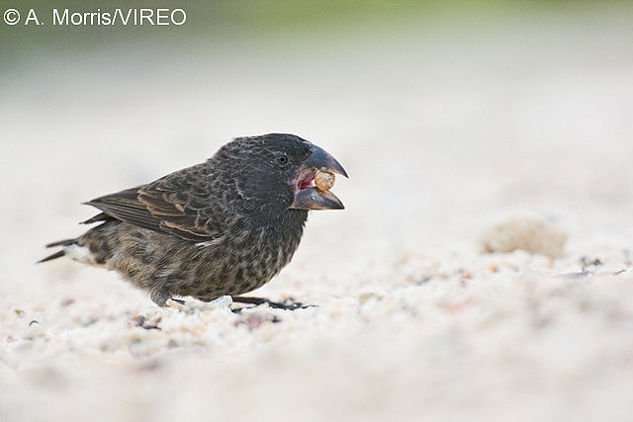
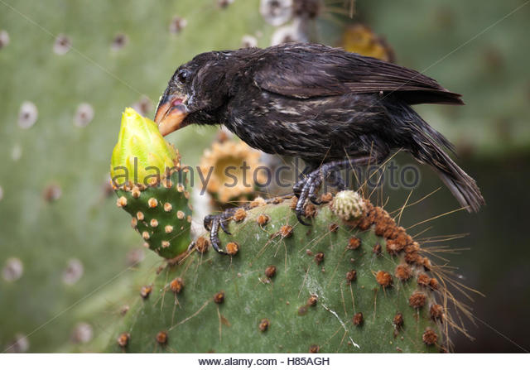
Evolutionary Theory
Darwin
Mental Continuity among species (justifies search for general laws of behavior)
Species diversity (there may be differences as well)
Insects Cactus fruit Seeds

Slide 11
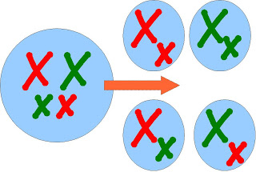
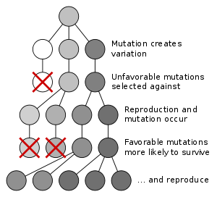
Evolutionary Theory
Darwin
Mental Continuity among species (justifies search for general laws of behavior)
Species diversity (there may be differences as well)
Evolutionary Theory:
1. Random Genetic Variation
2. Natural Selection

Slide 12
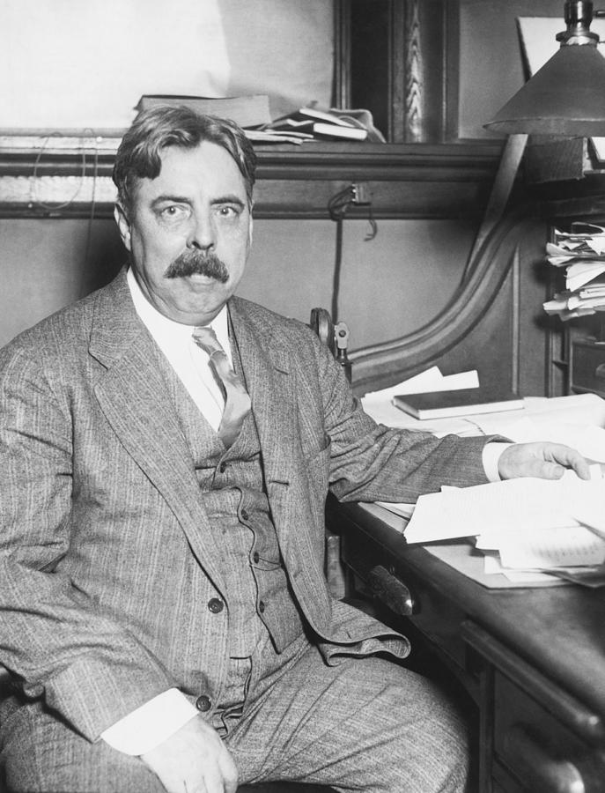
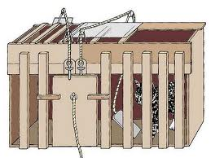
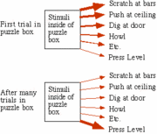
Evolutionary Theory
Thorndike
Applied idea of random variation and natural selection to help explain the behavior of individual organisms within their lifetime
This can be illustrated through his law of effect
Random Response variation
Reinforcement “selects” the correct response by strengthening a connection between the
stimulus situation and the correct response (S-R association)

