Slide 1
Lecture 20: Extinction
(Pavlovian & Instrumental)
Learning, Psychology 3510
Fall, 2018
Professor Delamater

Slide 2
Extinction: Procedure & Process
The extinction procedure refers to the removal of the outcome, when it previously occurred.
The effect of this is to reduce conditioned responding to near-baseline levels.
It also increases behavioral variability.
And produces emotional effects (e.g., frustration, aggression, relief, etc).

Slide 3








Extinction: Applied Significance
Cravings, Addictions, Phobias, PTSD, Depression – All of these have their own stimulus triggers
Extinction research attempts to understand how stimuli can LOSE their triggering effects.

Slide 4
Extinction: Applied Significance
1. Drug addict learns to crave drugs in certain environments
2. Gamblers have the urge to continue placing bets
3. Those suffering PTSD are extremely anxious in the presence of stimulus triggers
4. Phobics experience fearful of specific stimuli or situations
Eating disorders are accompanied by loss of control over eating decisions
Depressives encounter stimuli that evoke sadness.
In all these cases a target of therapy is to identify the environmental events that
lead to the unwanted behavior.
The issue is how to “extinguish” these unwanted behaviors from occurring when those
environmental events are experienced.

Slide 5
Extinction: Procedure & Process
One key issue is determining what psychological and neural processes are responsible
for this loss of responding. Is the response loss transient or permanent?
In other words, does extinction result in unlearning or new learning that opposes and
masks prior learning?

Slide 6
Extinction: Some Key Phenomena
Spontaneous Recovery
Renewal
Reinstatement
Each of these phenomena show that extinction is transient.
The key implication is that extinction is a process that does not completely eliminate
prior learning (i.e., it does not result in complete unlearning).
It is a process that also involves new inhibitory learning.
Lets explore these phenomena…

Slide 7
Extinction: Spontaneous Recovery
Rescorla, 2004 study
Magazine approach (goal tracking) conditioning with rats
CS1 and CS2 are each paired with the US in the Acquisition phase.
Then both CSs are extinguished in the Extinction phase.
CS2 is tested immediately after the extinction phase, but CS1 is tested after an 8-day delay.

Slide 8
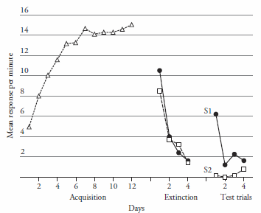
Extinction: Spontaneous Recovery
Rescorla, 2004 study
Magazine approach (goal tracking) conditioning with rats
CS1 and CS2 are each paired with the US in the Acquisition phase.
Then both CSs are extinguished in the Extinction phase.
CS2 is tested immediately after the extinction phase, but CS1 is tested after an 8-day delay.
Responding to CS1 spontaneously recovers over this time interval.
The results imply that extinction does not totally eliminate the original learning.
Pavlov was the first to observe this phenomenon, and he interpreted it to mean
that whereas “excitation” was learned in the acquisition phase, “inhibition” was
learned during the extinction phase. This inhibition only temporarily masked excitation
because it was assumed to be more labile than excitation and decayed over time.

Slide 9
Extinction: The Renewal Effect
Basic ABA renewal design
Context A Context B Context A vs B
CS-US CS- CS- test?
Rats first a CS-US association in Context A.
They then undergo extinction in a physically distinct Context B.
Then they are tested in either Context A OR Context B.
The usual result is that animals display more conditioned responding when tested in Context A than in Context B, i.e., there is a “renewal” of responding.

Slide 10
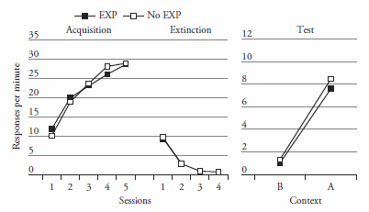
Extinction: The Renewal Effect
Bouton et al, 2011 ABA instrumental renewal study
Rats first learned to press a lever for food in Context A. Then they were extinguished
In Context B before being tested in both Contexts A and B.
Rats show “renewed” responding when tested in the conditioning context (A).
One group (Gp EXP) was also exposed to Context A without any lever or food during the
Extinction phase. The other group did not receive this extra treatment (Gp No EXP).
These two groups did not differ, suggesting that renewal did not occur simply because
Context A was more excitatory than Context B.

Slide 11
Extinction: The Renewal Effect
Renewal reflects the fact that extinction memories are difficult to retrieve when
testing occurs OUTSIDE of the extinction context.
This has an important implication for various behavior therapies….
The finding suggests that renewal should also be seen even when testing does not
occur in the training context. For example, ABC renewal:
Context A Context B Context C
CS-US CS- CS- test?
Renewal has been interpreted as a form of occasion setting, where the context
is the occasion setting stimulus. In particular, the extinction context is thought to
“set the occasion” by which the extinction memory (CS-No US) is retrieved.
In addition, one can use this idea to help explain spontaneous recovery where
time acts as a contextual stimulus. In that case, spontaneous recovery can be
thought of as a special case of ABC renewal.

Slide 12
Extinction: The Reinstatement Effect
Phase 1 Phase 2 Phase 3 Test
Gp Expt CS-US CS- US CS-?
Gp Control CS-US CS- -- CS-?
In the basic situation, two groups are given acquisition training followed by
extinction.
Then, one of the groups is exposed to the US by itself, and the effects of this on
responding to the CS are then observed.
More CRs are shown to the CS in this test in the group given those extra USs in Phase 3.
The CR to the CS has been “reinstated.”

Slide 13
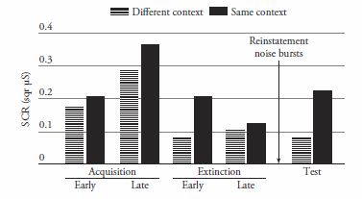
Extinction: The Reinstatement Effect
Phase 1 Phase 2 Phase 3 Test
Gp Same CS-US CS- US (same) CS-?
Gp Diff CS-US CS- US (diff) CS-?
LaBar & Phelps ran a variant of this basic design with humans (skin conductance task).
The only difference is that during Phase 3 they gave the US in the same context
as training & testing or in a different context in different groups of people.
They found greater responding to the CS
during the test in the people given
reinstating USs in the same context.
CS = blue square, US = loud noise
CR = skin conductance response
This result also shows that extinction
did not completely wipe out initial
learning, and that the effect is
context-specific.
LaBar & Phelps, 2005 study

Slide 14
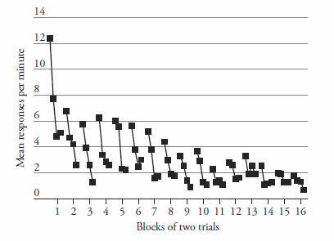
Extinction: Factors that Affect It
Number and Spacing of extinction trials:
  More trials lead to greater extinction.
  More widely spaced extinction trials lead to better extinction.
Repetition of extinction/test cycles: More repetitions lead to greater extinction.
Conducting extinction in multiple contexts: More contexts lead to more extinction learning.
Reminder cues: cues present during extinction can be effective even when the CS is tested in a different context (from where extinction took place).

Slide 15
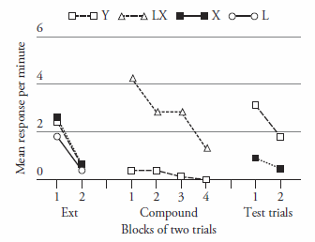
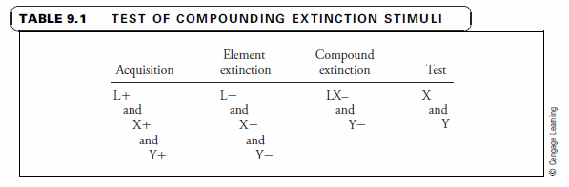
Extinction: Factors that Affect It
5. Compounding extinction stimuli
Rescorla, 2006 study
This experiment shows that a stimulus extinguished together with another
previously trained stimulus results in deepened extinction.

Slide 16
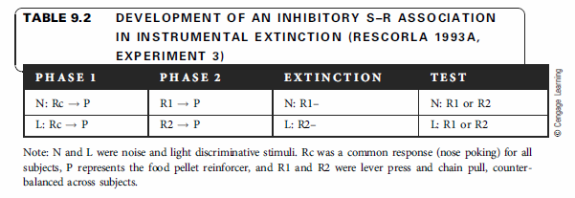
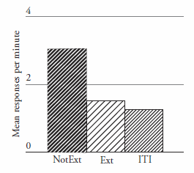
Extinction: What is Learned?
1. Attentional changes (e.g., habituation)
2. Emotional associations (S-O_{emot}, or R-O_{emot})
3. Partial Unlearning of S-O and R-O associations
4. Inhibitory S-R associations
5. Negative occasion setting: S excites R-no O association
6. Neural mechanisms: Amygdala, Prefrontal Cortext, Hippocampus interactions
This experiment shows that extinction of an instrumental response is specific
to the stimulus present at the time of extinction. The result can be understood
in terms of specific inhibitory S-R associations having been learned during extinction.
Another idea is that the stimulus acquires negative occasion setting properties:
S excites the R-no O association.

Slide 17
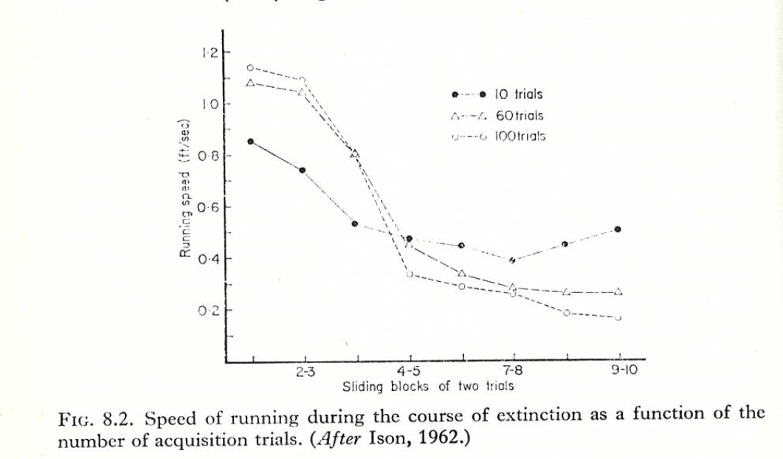
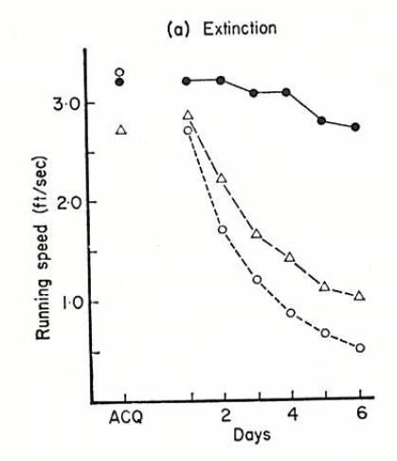
Extinction: Paradoxical Reward Effects
Amount of training (Overtraining Extinction Effect)
Magnitude of reward effects on extinction: Greater reward magnitudes used in training lead to faster extinction (in some but not all learning tasks).
Partial reinforcement extinction effect (PREE): Partially reinforced stimuli extinguish more slowly than continuously reinforced stimuli.
PRF
CRF

Slide 18
Extinction: Paradoxical Reward Effects
Amount of training (Overtraining Extinction Effect)
Magnitude of reward effects on extinction: Greater reward magnitudes used in training lead to faster extinction (in some but not all learning tasks).
Partial reinforcement extinction effect (PREE): Partially reinforced stimuli extinguish more slowly than continuously reinforced stimuli.
Theories of the PREE
Frustration theory (Amsel)
Sequential theory (Capaldi)
PRF
Frustration Theory: Nonreinforced trials induce frustration
and this serves as a cue (discriminative stimulus) for
reinforced responding. (Persistence in light of frustration pays off).
Sequential Theory: If the previous trial was nonreinforced,
its memory serves as a cue (discriminative stimulus) for
reinforcement on the next trial. (RNR vs RRN experiment…)
CRF

