Slide 1
Lecture 21: Avoidance Learning & Punishment
Learning, Psychology 3510
Fall, 2018
Professor Delamater

Slide 2
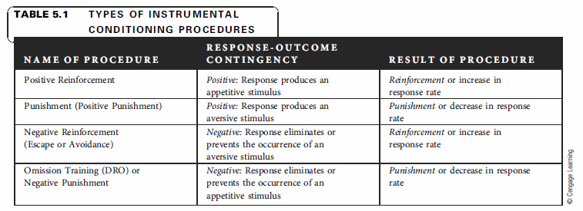
4 Basic Instrumental Contingencies
Recall that there are 4 basic types of instrumental contingencies. We’ve focused on positive reinforcement, but now lets talk about negative reinforcement and punishment. Once again, the 4 contingencies refer to when the…
Response leads to Positive Event (Positive Reinforcement)
Response leads to Negative Event (Punishment)
Response leads to termination or prevention of Negative Event (Negative Reinf)
Response leads to termination or prevention of a Positive Event (Omission)
Reinforcement procedures increase responding, the others decrease responding.

Slide 3
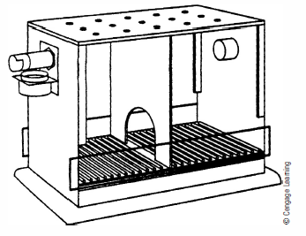
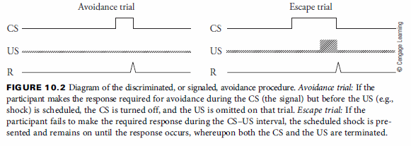
Avoidance Learning: 2 Tasks
1. Signaled Avoidance learning task (shuttle box avoidance)
Rats learn to escape foot shock by shuttling from one side to the other once shock
occurs in the presence of a warning stimulus.
They also learn to avoid foot shock by shuttling from one side to the other in the
presence of the warning stimulus prior to the scheduled shock delivery.

Slide 4
Avoidance Learning: 2 Tasks
2. Unsignaled Avoidance learning task (Sidman avoidance)
In this case rats will get a foot shock within a specific time interval if they do not make
the avoidance response. This is called the shock-shock interval (S-S).
If they make the target response (e.g., lever press, shuttle jump, wheel run, etc), this will
Delay the next shock for some time. This is called the response-shock interval (R-S).
Better avoidance learning occurs with short S-S and long R-S intervals.
The animals use the passage of time as a discriminative cue (a warning stimulus) for
when responding will be effective.

Slide 5
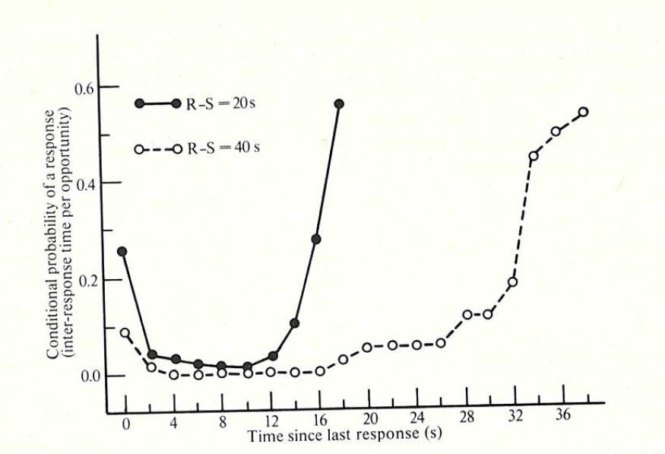
Avoidance Learning: 2 Tasks
2. Unsignaled Avoidance learning task (Sidman avoidance)
Sidman (1966)
Responding on this schedule increases over time since the last response, and is
related to the length of the response-shock (R-S) interval.

Slide 6
Avoidance Learning: Theoretical Approaches
The basic quandary: How does the non-occurrence of an event reinforce behavior???
After all, a successfully avoiding animal makes a response and nothing happens. Why should that continue to reinforce behavior? This problem plagued behaviorists who did not wish to admit that internal, non-observable, psychological processes figured into a theory of behavior. So, from this perspective it is not easy to see why the non-occurrence of something should have such a strong effect on behavior.

Slide 7
Avoidance Learning: Theoretical Approaches
1. Two-Process theory
Pavlovian Process (warning stimulus associates with shock US, and produces
a fear CR)
Instrumental Process (termination of the warning stimulus and the fear CR
negatively reinforces the response)
Evidence: Escape from Fear studies (EFF)

Slide 8
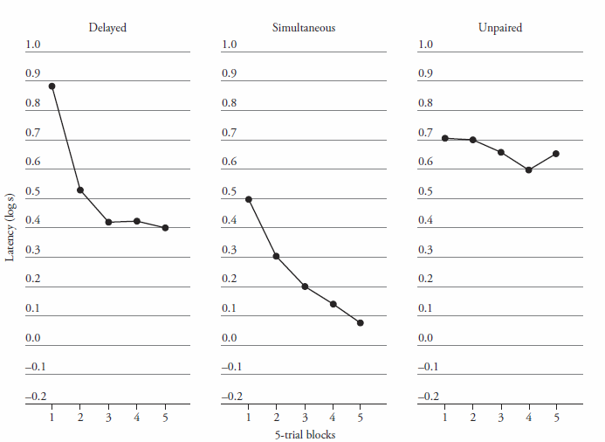
Avoidance Learning: Theoretical Approaches
1. Two-Process theory
Pavlovian Process (warning stimulus associates with shock US, and produces
a fear CR)
Instrumental Process (termination of the warning stimulus and the fear CR
negatively reinforces the response)
Evidence: Escape from Fear studies (EFF)
In this study, Pavlovian fear conditioning occurs first.
One group gets Delayed conditioning, another gets
simultaneous conditioning, and the third gets CS and US
Unpaired (this is the control group).
Then all groups are trained in a shuttle avoidance
task, but no shocks are presented. Instead, the CS is
presented and shuttle avoidance responses turn off the
CS.
The Delayed and Simultaneous pairings groups both show decreased shuttle avoidance
latencies over trials, whereas the unpaired group does not. This indicates that the response
is negatively reinforced simply as a function of turning off the aversive CS. This lends support for two-process assumptions.

Slide 9
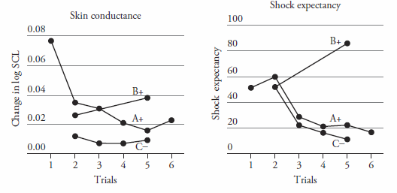
Avoidance Learning: Theoretical Approaches
1. Two-Process theory
Pavlovian Process (warning stimulus associates with shock US, and produces
a fear CR)
Instrumental Process (termination of the warning stimulus and the fear CR
negatively reinforces the response)
Evidence: Escape from Fear studies (EFF)
Problem: While the warning stimulus evokes a fear CR early in training, this
fear CR goes away with extended training even though the avoidance response
does not.
Lovibond, et al (2008) study
One stimulus, A+, signals avoidance.
A second, B+, is a Pavlovian CS.
A third, C-, is not paired with shock.
Humans could avoid finger shock (mild)
by pressing a key in the presence of A.
Skin conductance responses are a measure
of fear CRs, and these go down to A, but increase
On B+ trials over training.
Shock expectancies increase to B, but decrease to A.
This study shows that avoidance responding persists even when fear to A does not.

Slide 10
Avoidance Learning: Theoretical Approaches
Two-Process theory
Safety-signal Hypothesis
Safety signals are response-produced cues that signal the absence of shock.
They, in essence, become conditioned inhibitors of fear.
And, they positively reinforce the response that leads to them.
Evidence: Presenting an explicit stimulus following each avoidance response
results in that stimulus becoming a conditioned inhibitor of fear. These
explicit stimuli also speed up the rate of avoidance learning.

Slide 11
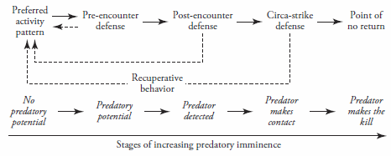
Avoidance Learning: Theoretical Approaches
Two-Process theory
Safety-signal Hypothesis
Safety signals are response-produced cues that signal the absence of shock.
They, in essence, become conditioned inhibitors of fear.
And, they positively reinforce the response that leads to them.
Evidence: Presenting an explicit stimulus following each avoidance response
results in that stimulus becoming a conditioned inhibitor of fear. These
explicit stimuli also speed up the rate of avoidance learning.
SSDR theory and concept of predatory imminence (remember behavior systems theory)
Some responses are easier to learn than others (e.g., running vs rearing)
This is because some responses are innate “species specific defense reactions”
Which behavior occurs depends
on how far away from the threat
the animal is at any moment.
This will partly determine the
type of avoidance responses seen.
E.g., rats and snakes….
Seek dark place Freezing explosive leaping

Slide 12
Avoidance Learning: Theoretical Approaches
Two-Process theory
Safety-signal Hypothesis
SSDR theory and concept of predatory imminence
Expectancy theory
Animals acquire R – No Shock and No R – Shock associations (expectations)
These determine avoidance responding, as a rational decision making process.
Explains why avoidance responding is difficult to extinguish.

Slide 13
Avoidance Learning: Theoretical Approaches
Two-Process theory
Safety-signal Hypothesis
SSDR theory and concept of predatory imminence
Expectancy theory
Animals acquire R – No Shock and No R – Shock associations (expectations)
These determine avoidance responding, as a rational decision making process.
Explains why avoidance responding is difficult to extinguish.
Interesting experiment: Learned Helplessness Effect
Animals in the yoked inescapable shock group later learn to avoid poorly.
Is this due to “learned helplessness” (an expectation that responding has no effect)?

Slide 14
Avoidance Learning: Theoretical Approaches
Two-Process theory
Safety-signal Hypothesis
SSDR theory and concept of predatory imminence
Expectancy theory
Animals acquire R – No Shock and No R – Shock associations (expectations)
These determine avoidance responding, as a rational decision making process.
Explains why avoidance responding is difficult to extinguish.
Interesting experiment: Learned Helplessness Effect
Animals in the yoked inescapable shock group later learn to avoid poorly.
Is this due to “learned helplessness” (an expectation that responding has no effect)?
But explicit backward cues following shock alleviate the harmful effects of inescapable shocks.
That result supports the view that safety signals play a role (Jackson & Minor, 1988, chap 5).

Slide 15
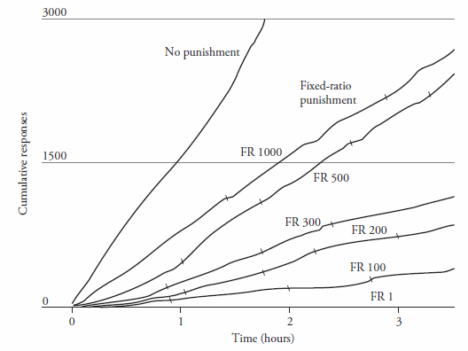
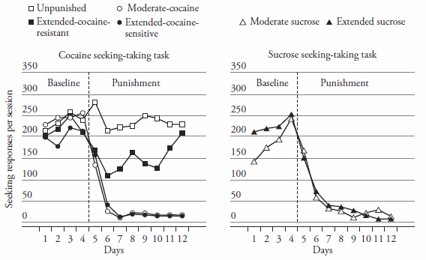
Punishment: Important Factors
Shock intensity & gradual increases in severity
Response contingency (contingent more effective than non-contingent shocks)
Delay of punishment (increasing delay reduces its effectiveness)
Schedules of punishment
Schedules of positive reinforcement (stronger reward contingencies hard to punish)
Availability of alternative reinforced responses
Effects of discriminative stimuli (learning when punishment can occur)
Punishment as a signal for availability of positive reinforcement (e.g., attention)
Azrin, Holz, & Hake, 1963
Pelloux, Everitt, & Dickinson, 2007
Even a small amount of contingent punishment
(FR 1000) can reduce appetitive responding
Extended cocaine self-admin results in
Resistance to punishment in some animals

Slide 16
Punishment: Theoretical Approaches
Conditioned emotional response theory
(Cues associated with punishment elicit a competing fear CR)
2. Avoidance theory (other competing behaviors are negatively reinforced)
3. Thorndike’s negative law of effect (punishment weakens the S-R association)
4. Expectancy theory (response associates with the punishing event)

