Slide 1
Lectures 15 & 16: Instrumental Conditioning (Schedules of Reinforcement)
Learning, Psychology 3510
Fall, 2018
Professor Delamater

Slide 2
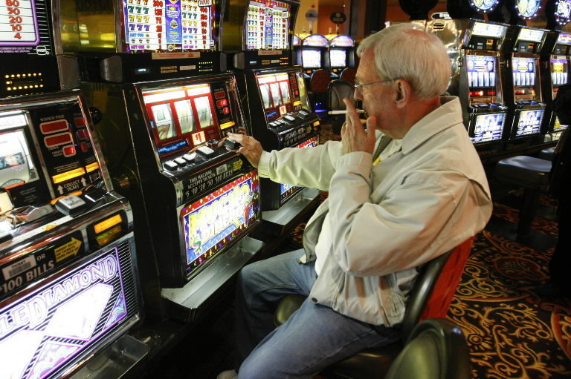
Instrumental Learning: Simple Schedules of Reinforcement
Life is learning to adapt to a bunch of reinforcement schedules…

Slide 3
Instrumental Learning: Simple Schedules of Reinforcement
Life is learning to adapt to a bunch of reinforcement schedules…
Ratio Schedules (Fixed or Variable)
Interval Schedules (Fixed or Variable)
For example: FR 10, VR 10, FI 60s, VI 60s
A “schedule of reinforcement” defines the rules by which reward
will be given to an organism for responding.
Rewards can be made to depend upon a set # of responses. This
is characteristic of a “ratio” schedule.
They can also be made to depend upon a set amount of elapsed
time. This is characteristic of an interval schedule.
Further, the set # or set amount of time can be fixed or variable.

Slide 4
Instrumental Learning: Simple Schedules of Reinforcement
Examples of Ratio Schedules:
CRF (”continuous reinforcement” - every response is rewarded)
PRF (partial reinforcement – only some Rs rewarded)
FR 1 = CRF
FR 10: 10 responses required to get a reward
(salesman working on commission)
VR 10: on average 10 responses required
(playing a slot machine…)
Examples of Interval Schedules
FI 60s: 1st response after 60 s is rewarded
(Studying for exams throughout the term)
VI 60s: 1st response after X s is rewarded
(where x=60s on average) (studying with pop quizzes)

Slide 5
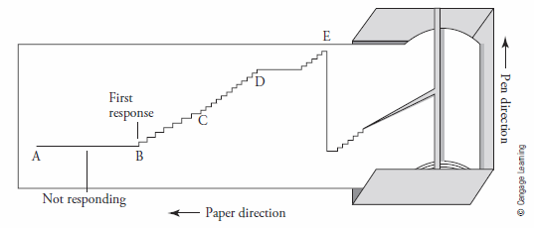
Instrumental Learning: Simple Schedules of Reinforcement
Different schedules produce different response patterns
Response patterns can be read from a “cumulative recorder”
Cumulative responses is indicated over time.
The slope of the line is a measure of response rate – steeper slope, faster rate.

Slide 6
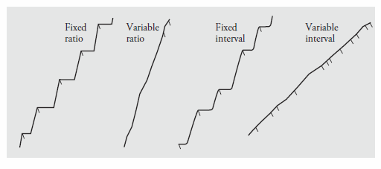
Instrumental Learning: Simple Schedules of Reinforcement
Different schedules produce different response patterns
FR – Pause and Run pattern
VR – Steady rate (fairly quick, though not as quick as run phase of FR)
FI – Scallop pattern (slow initially, increase as interval approaches)
VI – Steady rate (slower than VR)

Slide 7
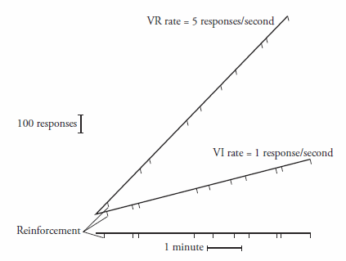
Instrumental Learning: Simple Schedules of Reinforcement
Ratio schedules promote faster rates of responding than interval schedules
With overall reinforcement rates held constant, VR produces faster
responding than VI.

Slide 8
Instrumental Learning: Simple Schedules of Reinforcement
Ratio schedules promote faster rates of responding than interval schedules. WHY?
Feedback functions for ratio and interval schedules differ:
Reinforcement rate increases with Response rate on Ratio,
but NOT on Interval Schedules

Slide 9
Instrumental Learning: Simple Schedules of Reinforcement
Ratio schedules promote faster rates of responding than interval schedules. WHY?
1. Feedback functions for ratio and interval schedules differ:
Reinforcement rate increases with Response rate on Ratio,
but NOT on Interval Schedules
Also, Ratio schedules reinforce short IRTs (inter-response times)
whereas Interval schedules reinforce longer IRTs.

Slide 10
Instrumental Learning: Choice
Concurrent Schedules of Reinforcement

Slide 11
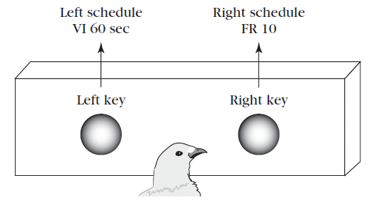
Instrumental Learning: Choice
Concurrent Schedules of Reinforcement
Two simple schedules are in effect simultaneously
e.g., Conc VI 60s VI 30
VI 30 sec
(Key A)
(Key B)

Slide 12
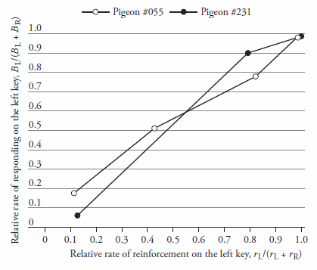
Instrumental Learning: Choice
Herrnstein’s Matching Law - Relative Rate of Responding matches the Relative Rate of Reinforcement
B_{B} r_{B}
(B_{A} + B_{B}) (r_{A} + r_{B})
=
VI 30 sec
(Key A)
(Key B)

Slide 13
Instrumental Learning: Choice
Herrnstein’s Matching Law - Relative Rate of Responding matches the Relative Rate of Reinforcement
B_{B} r_{B}
(B_{A} + B_{B}) (r_{A} + r_{B})
=
VI 30 sec
(Key A)
(Key B)
This means that choice of any one behavior
Reflects the degree to which OTHER behaviors
Can be reinforced in the situation. This could be
Related to problem behaviors like drug abuse,
unprotected sex, criminality, etc.

Slide 14
Instrumental Learning: Choice
Herrnstein’s Matching Law – Why does matching occur?
Molecular (or Momentary) Maximizing
Local probability of reinforcement directs behavior.
VI 30 sec
Animal chooses the response option that has the highest payoff
probability at that moment in time.

Slide 15
Instrumental Learning: Choice
Herrnstein’s Matching Law – Why does matching occur?
2. Melioration Theory
Local rates of reinforcement direct behavior.
VI 30 sec
Animal chooses the response option that has the highest experienced
reinforcement rate, and then keeps adjusting until the same experienced rates
occur on each side.

Slide 16
Instrumental Learning: Choice
Herrnstein’s Matching Law – Why does matching occur?
2. Melioration Theory
Local rates of reinforcement direct behavior.
Animal chooses the response option that has the highest experienced
reinforcement rate, and then keeps adjusting until the same experienced rates
occur on each side.

Slide 17
Instrumental Learning: Self Control
Concurrent-Chain Schedules
Animal makes a “commitment” response to gain access to a simple schedule of reinforcement.
Choice Link leads to Terminal Link of the schedule
Response choice in the initial link can be studied.
In this example, does the bird prefer working for reward after a Variable or
Fixed interval? Answer: They prefer the variable.

Slide 18
Instrumental Learning: Self Control
Concurrent-Chain Schedules
Small, 1” delay
Large, 5” delay
This task can be used to study
“Self Control”
One option leads to small immediate
Reward, while the other option leads to a large but delayed reward.
Is the bird Impulsive or Thoughtful???
Answer: It depends on the Delayed Discounting Function.

Slide 19
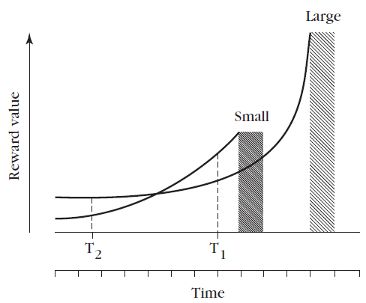
Instrumental Learning: Self Control
Concurrent-Chain Schedules
Small, 1” delay
Large, 5” delay
Delayed Discounting Function:
The subjective value of the reward decreases as a function of waiting time.
The relative values of the two options at any moment (T₁, T₂) determines
choice.

Slide 20
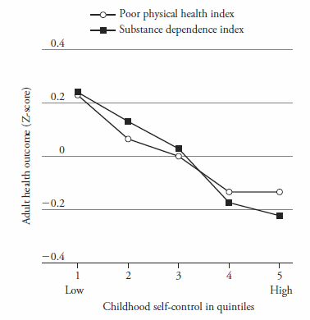
Instrumental Learning: Self Control
Concurrent-Chain Schedules
Small, 1” delay
Large, 5” delay
Interestingly, how well you are able to display self-control as a child predicts
how healthy you become as an adult.
Also, an organism’s “delay discounting function” may also predict their proclivity
towards developing a substance abuse problem (as revealed in animal studies).

