Slide 1
Lectures 5&6: Pavlovian Conditioning (Basic Concepts & Generality)
Learning, Psychology 3510
Fall, 2018
Professor Delamater

Slide 2
Pavlovian Learning
Three Key Questions
1. What are the major determinants of learning?
2. What is the content of learning?
3. How does learning get translated into performance?

Slide 3
Pavlovian Learning: Basic Paradigms
Eyeblink Conditioning (rabbits, rats)
Conditioned Taste Aversion (rats, mice)
Conditioned Flavor Preference (rats, mice)
Fear Conditioning (rats, mice)
Appetitive Conditioning (Magazine Approach, rats)
Autoshaping (pigeons, rats)
Drug Conditioning (rats)
Sexual Conditioning (fish, Japanese quail, rats)

Slide 4
Pavlovian Learning: Basic Paradigms
Eyeblink Conditioning (rabbits, rats)
Conditioned Taste Aversion (rats, mice)
Conditioned Flavor Preference (rats, mice)
Fear Conditioning (rats, mice)
Appetitive Conditioning (Magazine Approach, rats)
Autoshaping (pigeons, rats)
Drug Conditioning (rats)
Sexual Conditioning (fish, Japanese quail, rats)
The variety of ways to study Pavlovian learning shows that this process affects
a large number of response systems (motor reflex, affect, emotions, motivations, whole
body movements, physiological effects of drugs, sex), and is, therefore, quite a
general psychological process.

Slide 5
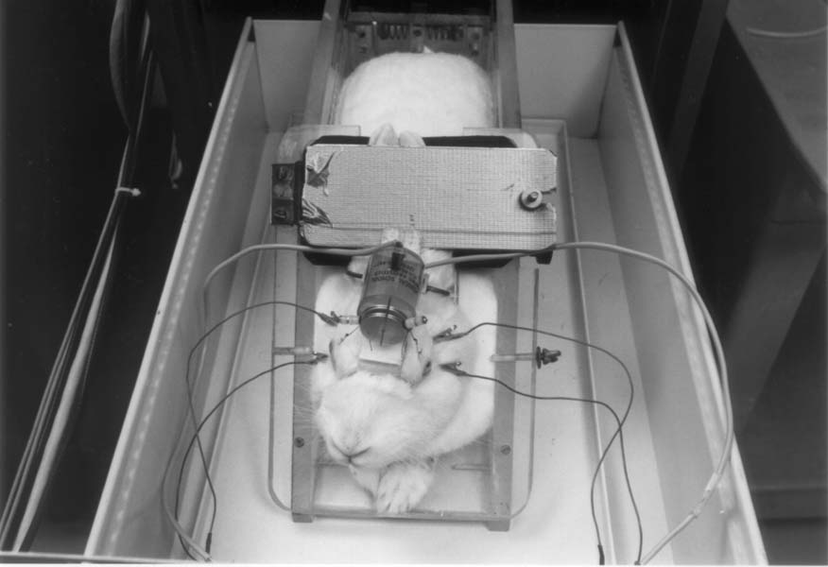
Pavlovian Learning: Basic Paradigms
Eyeblink Conditioning
750 ms Tone CS - Airpuff US
monitor eyeblink CR to Tone

Slide 6
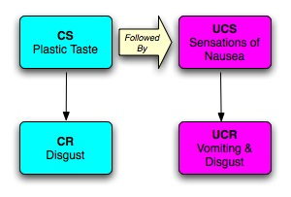
Pavlovian Learning: Basic Paradigms
2. Conditioned Taste Aversion Conditioning
monitor Taste Intake, Taste Reactivity Response

Slide 7
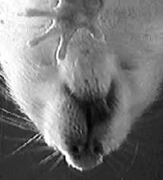
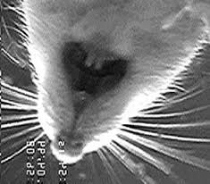
Pavlovian Learning: Basic Paradigms
2. Conditioned Taste Aversion Conditioning
monitor Taste Intake, Taste Reactivity Response
https://www.youtube.com/watch?v=_NdyMEvTSyE

Slide 8
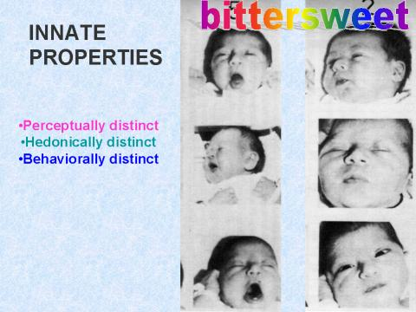
Pavlovian Learning: Basic Paradigms
2. Conditioned Taste Aversion Conditioning
monitor Taste Intake, Taste Reactivity Response
https://www.youtube.com/watch?v=_NdyMEvTSyE

Slide 9
Pavlovian Learning: Basic Paradigms
3. Conditioned Flavor Preference Conditioning
Cherry + Sucrose Cherry > Grape
Grape -
Cherry -> IG Sucrose Cherry > Grape
Grape -> IG Water
monitor Taste Intake, Taste Reactivity Response

Slide 10
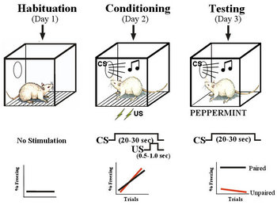

Pavlovian Learning: Basic Paradigms
Fear Conditioning:
a. Conditioned Emotional Response – CER
(also known as conditioned suppression)
b. Conditioned freezing
monitor Freezing, Conditioned Suppression

Slide 11
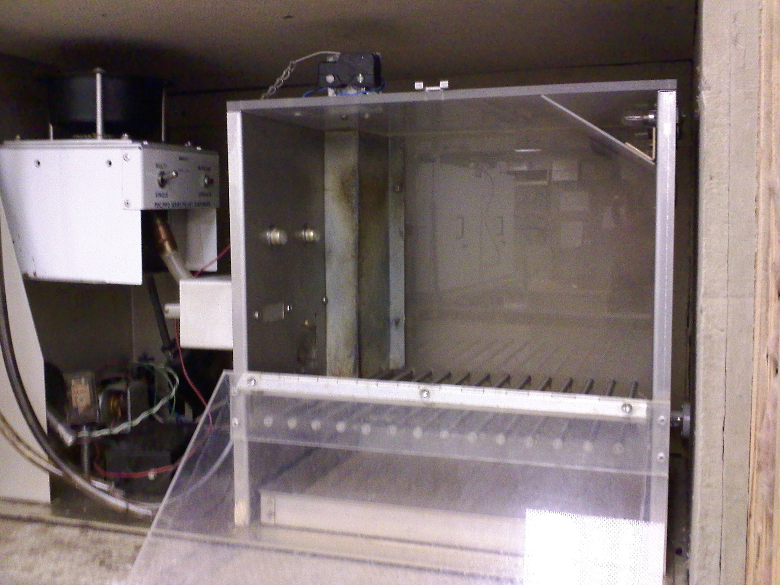
Pavlovian Learning: Basic Paradigms
5. Magazine Approach Conditioning (Goal Tracking)
Tone CS - Food US
Monitor food cup (magazine) approach during Tone

Slide 12
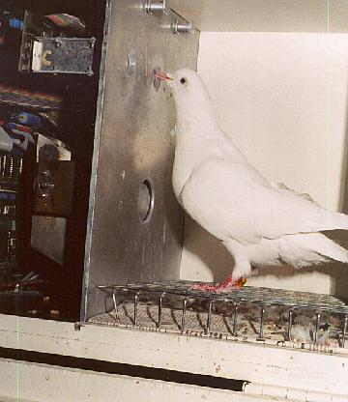

Pavlovian Learning: Basic Paradigms
6. Autoshaping (Sign Tracking)
10” Keylight CS - Food US
Monitor keypecks during CS

Slide 13
Pavlovian Learning: Basic Paradigms
7. Drug Conditioning
Context CS - Drug US
| |
Drug Drug Response
Opposite
Response
Conditioned Compensatory CRs
Tolerance is Context-Specific

Slide 14
Pavlovian Learning: Basic Paradigms
7. Drug Conditioning
Context CS - Morphine US
| |
Hyperalgesia Analgesia
Conditioned Compensatory CRs
Test for pain sensitivity in context without drug
Tolerance is Context-Specific
Test for pain sensitivity in New context with drug

Slide 15
Pavlovian Learning: Basic Paradigms
8. Sexual Conditioning (Japanese Quail, Rats, Fish, etc)
Visual CS - Sexual Activity US
Conditioned approach to CS

Slide 16
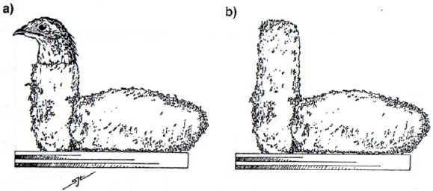
Pavlovian Learning: Basic Paradigms
8. Sexual Conditioning (Japanese Quail, Rats, Fish, etc)
Visual CS - Sexual Activity US
Conditioned approach to CS
Conditioned mounting CRs

Slide 17
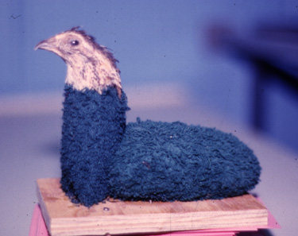
Pavlovian Learning: Basic Paradigms
8. Sexual Conditioning (Japanese Quail, Rats, Fish, etc)
Visual CS - Sexual Activity US
Conditioned approach to CS
Conditioned mounting CRs

Slide 18
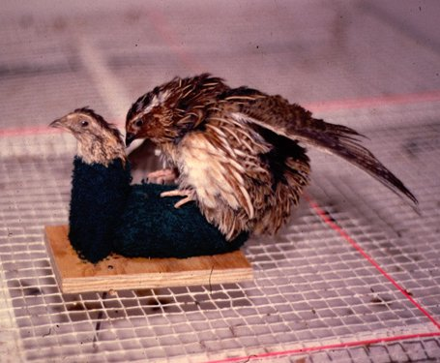
Pavlovian Learning: Basic Paradigms
8. Sexual Conditioning (Japanese Quail, Rats, Fish, etc)
Visual CS - Sexual Activity US
Conditioned approach to CS
Conditioned mounting CRs
Conditioned effects on sperm production

Slide 19
Pavlovian Learning: Basic Concepts
1. Excitatory Conditioning – Learn a Positive CS-US Relationship
2. The Need for Control Conditions
3. Inhibitory Conditioning – Learn a Negative CS-US Relationship

Slide 20
Pavlovian Learning: Basic Concepts
1. Excitatory Conditioning – Learn a Positive CS-US Relationship
Procedures:
Short Delay, Long Delay, Trace, Simultaneous, Backward
The CS can occur before, during
or after the US occurs.
Each of these different temporal
arrangements is called a different
type of procedure.
Notice that the “Law of Temporal
Contiguity” can be studied by
comparing learning in these
different procedures.

Slide 21
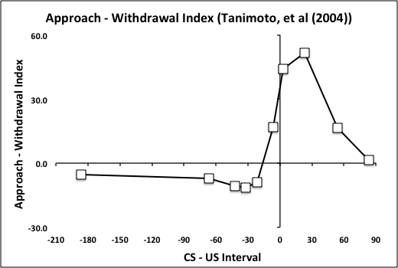
Pavlovian Learning: Basic Concepts
1. Excitatory Conditioning – Learn a Positive CS-US Relationship
Procedures:
Short Delay, Long Delay, Trace, Simultaneous, Backward
Generally speaking, the better
the temporal contiguity,
the better the learning.
But there are some exceptions…
Tanimoto, et al, (2004)

Slide 22
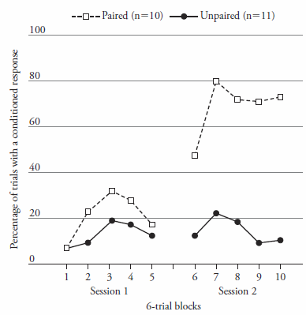
Pavlovian Learning: Basic Concepts
1. Excitatory Conditioning – Learn a Positive CS-US Relationship
Procedures:
Short Delay, Long Delay, Trace, Simultaneous, Backward
2. The Need for Control Conditions
Three types of control procedures:
Explicitly Unpaired, Truly Random, Novel CS
Differences relative to control group reflect
associative learning caused by the CS-US relation
as opposed to non-associative effects
(like sensitization or pseudo-conditioning).
Eyeblink conditioning in human infants

Slide 23
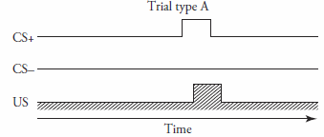
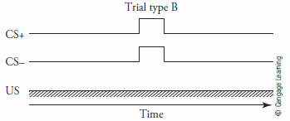

Pavlovian Learning: Basic Concepts
3. Inhibitory Conditioning – Learn a Negative CS-US Relationship
Procedures for Establishing Conditioned Inhibition:
Pavlovian Conditioned Inhibition, Negative Contingency
Pavlovian CI:
(A+, AX-)
Negative Contingency:
In both cases, the inhibitory cue becomes a signal for No US.
In Fear conditioning, this becomes a “safety signal.”

Slide 24
Pavlovian Learning: Basic Concepts
3. Inhibitory Conditioning – Learn a Negative CS-US Relationship
Procedures for Measuring Conditioned Inhibition:
Bidirectional response, Summation Test, Retardation of Acquisition Test

Slide 25
Pavlovian Learning: Basic Concepts
3. Inhibitory Conditioning – Learn a Negative CS-US Relationship
Procedures for Measuring Conditioned Inhibition:
Bidirectional response, Summation Test, Retardation of Acquisition Test
Tanimoto, et al, (2004): Bidirectional response measure of conditioned excitation and inhibition
Fruit flies (Drosophila melanogaster) trained in a tube
One odor is paired with electric shock (various CS-US intervals)
The other odor is unpaired with shock
Flies are then tested in a 2-compartment T-maze
Approach to or withdrawal from the shock paired
odor is measured.
Forward pairings result in graded withdrawal
Short backward pairings result in approach

Slide 26
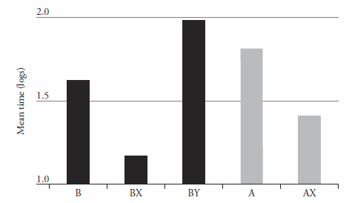
Pavlovian Learning: Basic Concepts
3. Inhibitory Conditioning – Learn a Negative CS-US Relationship
Procedures for Measuring Conditioned Inhibition:
Bidirectional response, Summation Test, Retardation of Acquisition Test
Cole, et al, (1997): Summation test for conditioned inhibition
Rats trained in a fear conditioning situation
Training trials: A+, AX-, B+
Test trials: A-, AX-, B-, BX-, BY-
Measure time to complete 5 sec of licking
on a water tube in the presence of the stimuli.
This is a measure of conditioned “lick suppression.”
Lots of suppression caused by A and B alone
Less suppression to AX.
Less suppression to BX. This indicates summation (of excitatory B with inhibitory X).
The control stimulus, Y, however, does not alleviate lick suppression to B on BY test. So we can
be sure that the effect of X on B’s suppression is due to X’s conditioned inhibitory properties.

Slide 27
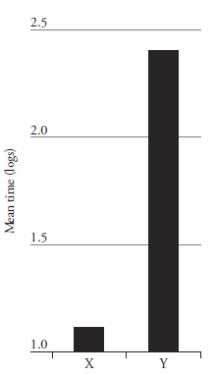
Pavlovian Learning: Basic Concepts
3. Inhibitory Conditioning – Learn a Negative CS-US Relationship
Procedures for Measuring Conditioned Inhibition:
Bidirectional response, Summation Test, Retardation of Acquisition Test
Cole, et al, (1997): Retardation of acquisition test for conditioned inhibition
Rats trained in a fear conditioning situation
Training trials: A+, AX-
Test trials: X+, Y+
Measure “lick suppression.”
Lick suppression acquired most rapidly to Y than X.
This indicates slower excitatory learning to X. Why?
Because X had earlier been trained as an inhibitor for the shock US,
and this interfered with excitatory learning.
In all 3 cases, “conditioned inhibition” is in some ways seen as the
conceptual opposite of conditioned excitation. It seems to oppose that
excitation.

