Slide 1
Lectures 7&8: Pavlovian Conditioning (Determining Conditions)
Learning, Psychology 3510
Fall, 2018
Professor Delamater

Slide 2
Pavlovian Learning
Three Key Questions
1. What are the major determinants of learning?
2. What is the content of learning?
3. How does learning get translated into performance?

Slide 3
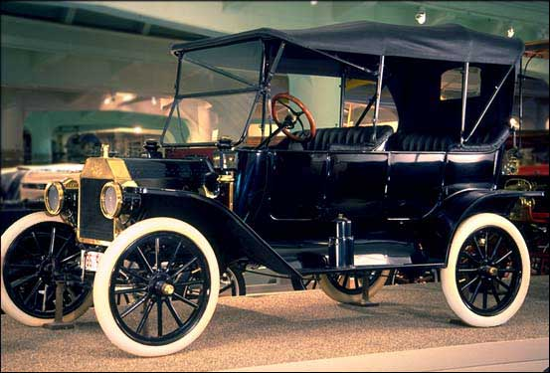


Pavlovian Learning

Slide 4



Pavlovian Learning
?
?
?

Slide 5
Pavlovian Learning
-
-
-

Slide 6
Pavlovian Learning: Determining Conditions
Stimulus Novelty (CS, US)
Stimulus Intensity (CS, US)
Spatial Contiguity
Temporal Contiguity
Relative Temporal Contiguity
CS-US Contingency
US Surprise
Relative Cue Validity
CS-US Relevance (Belongingness)
What factors influence whether or not you will see Pavlovian
excitatory conditioning, as well as the extent of such conditioning?
Answer: There are lots of important factors (listed above)….

Slide 7
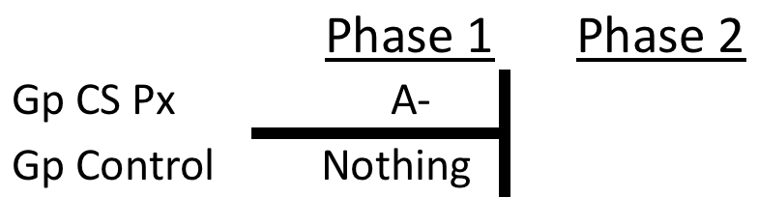
Stimulus Novelty: CS Novelty
CS Preexposure Effect (aka “latent inhibition”)
A+
One group is exposed to the CS without any US during Phase 1. The other group
serves as the “control” group against which to assess the effects of CS preexposures.

Slide 8
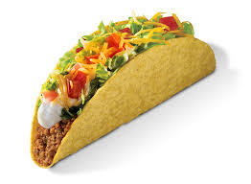
Stimulus Novelty: CS Novelty
CS Preexposure Effect (aka “latent inhibition”)
A+
Tacos – No Illness | Tacos – Illness
vs
No Tacos | Tacos – Illness
In which case would you expect a taco aversion to develop?
One group is exposed to the CS without any US during Phase 1. The other group
serves as the “control” group against which to assess the effects of CS preexposures.

Slide 9
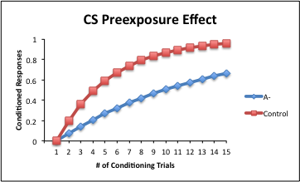
Stimulus Novelty: CS Novelty
CS Preexposure Effect (aka “latent inhibition”)
A+
Tacos – No Illness | Tacos – Illness
vs
No Tacos | Tacos – Illness
In which case would you expect a taco aversion to develop?
One group is exposed to the CS without any US during Phase 1. The other group
serves as the “control” group against which to assess the effects of CS preexposures.
The Preexposed Group acquires conditioned responding slowly.

Slide 10
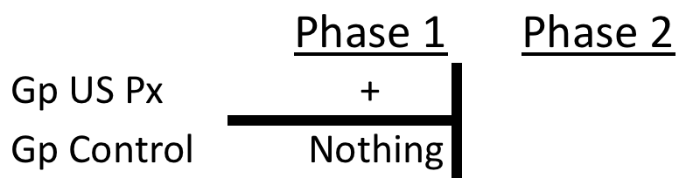
Stimulus Novelty: US Novelty
US Preexposure Effect
A+
Illness | Tacos – Illness
vs
No Illness | Tacos – Illness
In which case would you expect a taco aversion to develop?
One group is exposed to the US without any CS during Phase 1. The other group
serves as the “control” group against which to assess the effects of US preexposures.

Slide 11
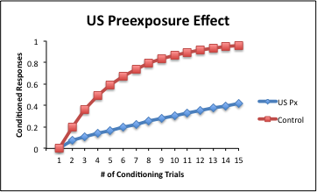
Stimulus Novelty: US Novelty
US Preexposure Effect
A+
Illness | Tacos – Illness
vs
No Illness | Tacos – Illness
In which case would you expect a taco aversion to develop?
One group is exposed to the US without any CS during Phase 1. The other group
serves as the “control” group against which to assess the effects of CS preexposures.
The Preexposed Group acquires conditioned responding slowly.

Slide 12
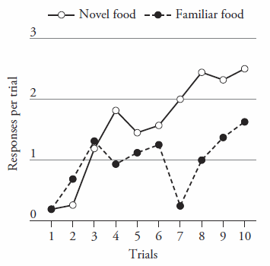
Stimulus Novelty: US Novelty
Franklin & Hall, 2011
US Preexposure Effect
A+
| Lever 1 CS – Bacon Pellets
Bacon Pellets| vs
| Lever 2 CS – Choc Pellets
In which case would you expect lever contact CRs to develop?
Franklin & Hall (2011) showed the effect in the same animals in a lever sign tracking
Experiment. One of two foods was preexposed, then one lever was paired with the
Preexposed food (e.g., bacon pellet) and the other lever with a different food (chocolate).

Slide 13
Stimulus Intensity
CS Intensity
Weak Tone – Foot Shock US
vs
Strong Tone – Foot Shock US
Which group would you expect to learn more rapidly?

Slide 14
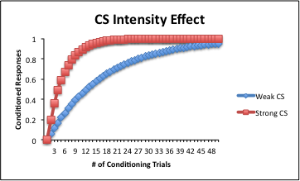
Stimulus Intensity
CS Intensity
Weak Tone – Foot Shock US
vs
Strong Tone – Foot Shock US
Which group would you expect to learn more rapidly?
The group trained with the strong tone learns more rapidly because this is a
more “salient” stimulus and more salient stimuli receive more processing and are,
therefore, learned about more quickly.
However, most typically, the less salient stimulus eventually catches up and they
both end up at the same level of conditioning, i.e., they both reach the same asymptote.

Slide 15
Stimulus Intensity
US Intensity
Tone – Strong Foot Shock US
vs
Tone – Weak Foot Shock US
Which group would you expect to learn more rapidly?

Slide 16
Stimulus Intensity
US Intensity
Tone – Strong Foot Shock US
vs
Tone – Weak Foot Shock US
Which group would you expect to learn more rapidly?
The group trained with the strong shock US learns more rapidly because this is a
more “salient” US and more salient USs receive more processing and can,
therefore, support more rapid learning.

Slide 17
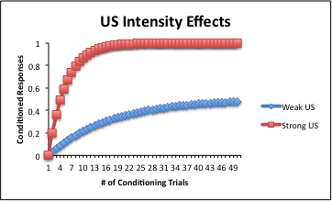
Stimulus Intensity
US Intensity
Tone – Strong Foot Shock US
vs
Tone – Weak Foot Shock US
Which group would you expect to learn more rapidly?
The group trained with the strong shock US learns more rapidly because this is a
more “salient” US and more salient USs receive more processing and can,
therefore, support more rapid learning.
They also seem to support higher levels of learning too. In other words, strong USs
result in a faster acquisition rate and a higher asymptote of learning.

Slide 18
Spatial Contiguity
CS & US are better associated if they both occur in the
same spatial location than when they are from different locations.

Slide 19
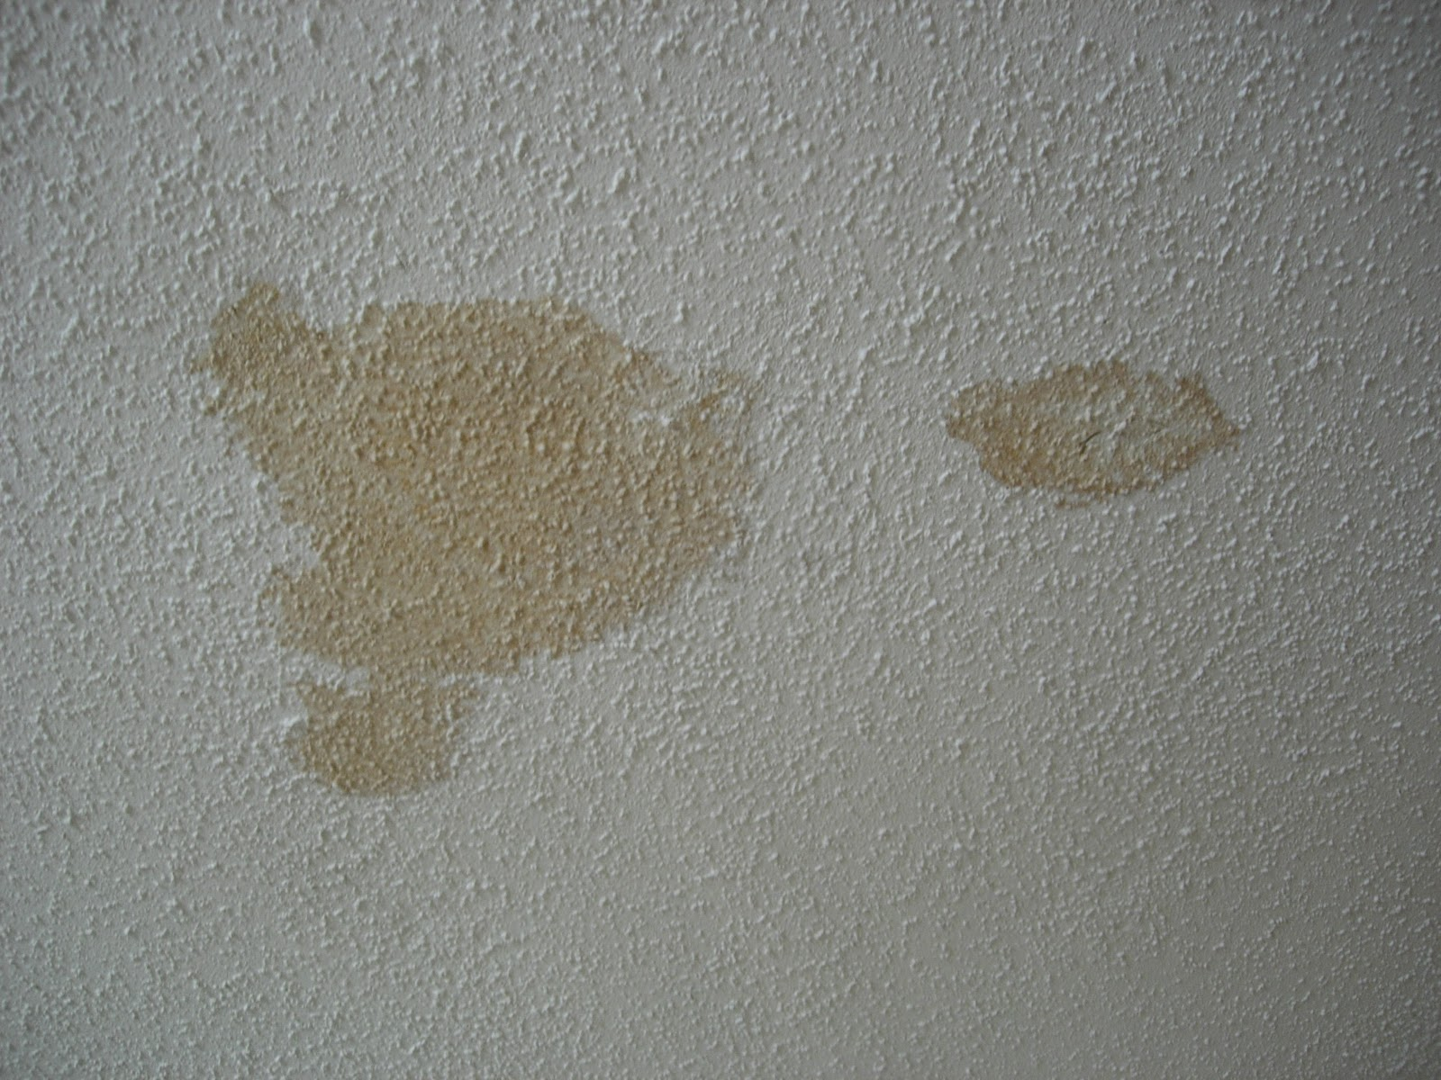

Spatial Contiguity
CS & US are better associated if they both occur in the
same spatial location than when they are from different locations.
For example, water stain on the ceiling is better associated with a leaking pipe
that occurs directly overhead, versus a pipe that is not directly overhead.
+

Slide 20
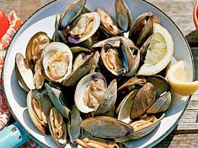

Spatial Contiguity
CS & US are better associated if they both occur in the
same spatial location than when they are from different locations.
Another example is food aversion learning. We think of foods and illness both being processed in the gut, and this could help their association formation.
+

Slide 21
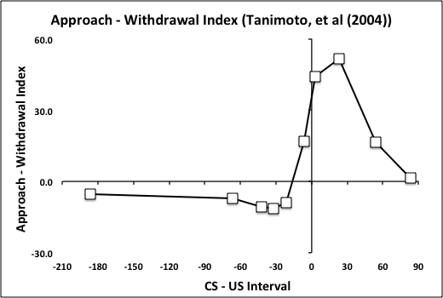
Temporal Contiguity
Tanimoto et al (2004) Study, revisited
CS & US are better associated if they occur closely
together in time.
Fruit fly study: Flies avoid an odor paired with shock, but some forward
CS-US intervals are better than others. This avoidance decreases as the CS-US interval
Increases beyond a certain point.

Slide 22
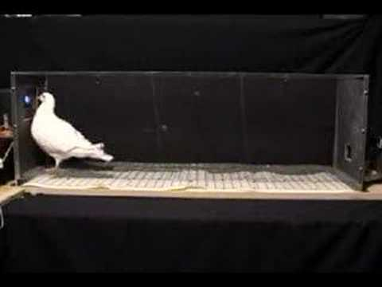
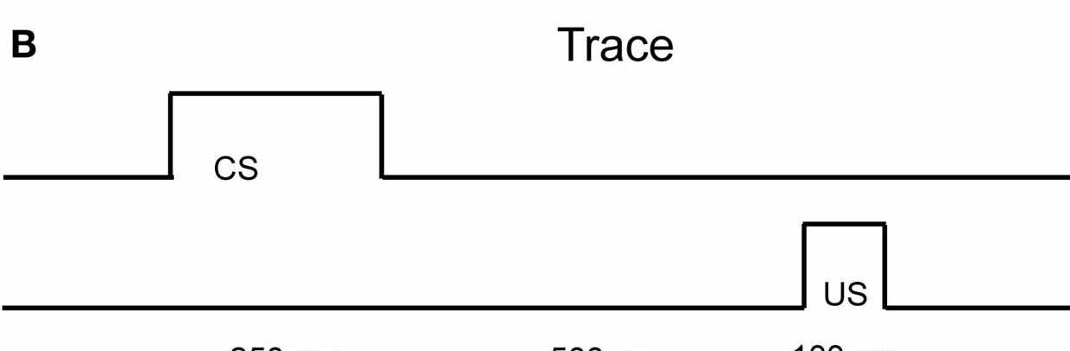
Relative Temporal Contiguity
Kaplan (1978) Study
CS-US interval relative to the ITI that affects learning.
Short ITI
*** Long ITI ***
Pigeon autoshaping paradigm
Two groups trained with a trace conditioning procedure (Key Light – Gap – Grain)
One group trained with a short inter-trial interval (ITI), and one group with a long ITI.
Both groups have the SAME CS-US interval, i.e., the same CS-US temporal contiguity.
However, the Long ITI group acquires conditioned approach to the Key Light, but the
Short ITI group acquires conditioned withdrawal from the Key Light.
Clearly, the absolute temporal contiguity doesn’t tell the whole story.
Relative temporal contiguity is also important (CS-US interval relative to the ITI).

Slide 23
CS-US Contingency
Contingency Experiment (Rescorla, 1968)
Prob (US|CS) = 0.5, Prob (US|no CS) = 0, delta P = 0.5
CS
US
Time →
Fear conditioning paradigm with rats (Tone CS and foot shock US – measure suppression).
The Control Group was trained with a “positive contingency” (shown above).
This diagram illustrates the basic procedure. Half of the CSs were paired with a US.
Notice that “contingency” is defined in terms of a difference (delta P) between two
conditional probabilities (P (US|CS) and P(US|no CS)).

Slide 24
CS-US Contingency
Contingency Experiment (Rescorla, 1968)
Prob (US|CS) = 0.5, Prob (US|no CS) = 0, delta P = 0.5
CS
US
Prob (US|CS) = 0.5, Prob (US|no CS) = 0.5, delta P = 0.0
CS
US
Time →
Fear conditioning paradigm with rats (Tone CS and foot shock US – measure suppression).
Two groups were trained, one with a “positive contingency” and one a “zero contingency.”
These two diagrams illustrate the basic procedure given to the two groups of rats.
Notice that “contingency” is defined in terms of a difference (delta P) between two
conditional probabilities (P (US|CS) and P(US|no CS)).

Slide 25
CS-US Contingency
Contingency Experiment (Rescorla, 1968)
Prob (US|CS) = 0.5, Prob (US|no CS) = 0, delta P = 0.5
CS
US
Prob (US|CS) = 0.5, Prob (US|no CS) = 0.5, delta P = 0.0
CS
US
Time →
Fear conditioning paradigm with rats (Tone CS and foot shock US – measure suppression).
Two groups were trained, one with a “positive contingency” and one a “zero contingency.”
Both Groups have the same # of CS-US pairings and their temporal contiguity is the same.

Slide 26
CS-US Contingency
Contingency Experiment (Rescorla, 1968)
Prob (US|CS) = 0.5, Prob (US|no CS) = 0, delta P = 0.5
CS
US
Prob (US|CS) = 0.5, Prob (US|no CS) = 0.5, delta P = 0.0
CS
US
Time →
Fear conditioning paradigm with rats (Tone CS and foot shock US – measure suppression).
Two groups were trained, one with a “positive contingency” and one a “zero contingency.”
Both Groups have the same # of CS-US pairings and their temporal contiguity is the same.
HOWEVER, only the positive contingency group learns to fear the CS.
Therefore, temporal contiguity is NOT sufficient for learning. CS-US contingency is also
important.

Slide 27

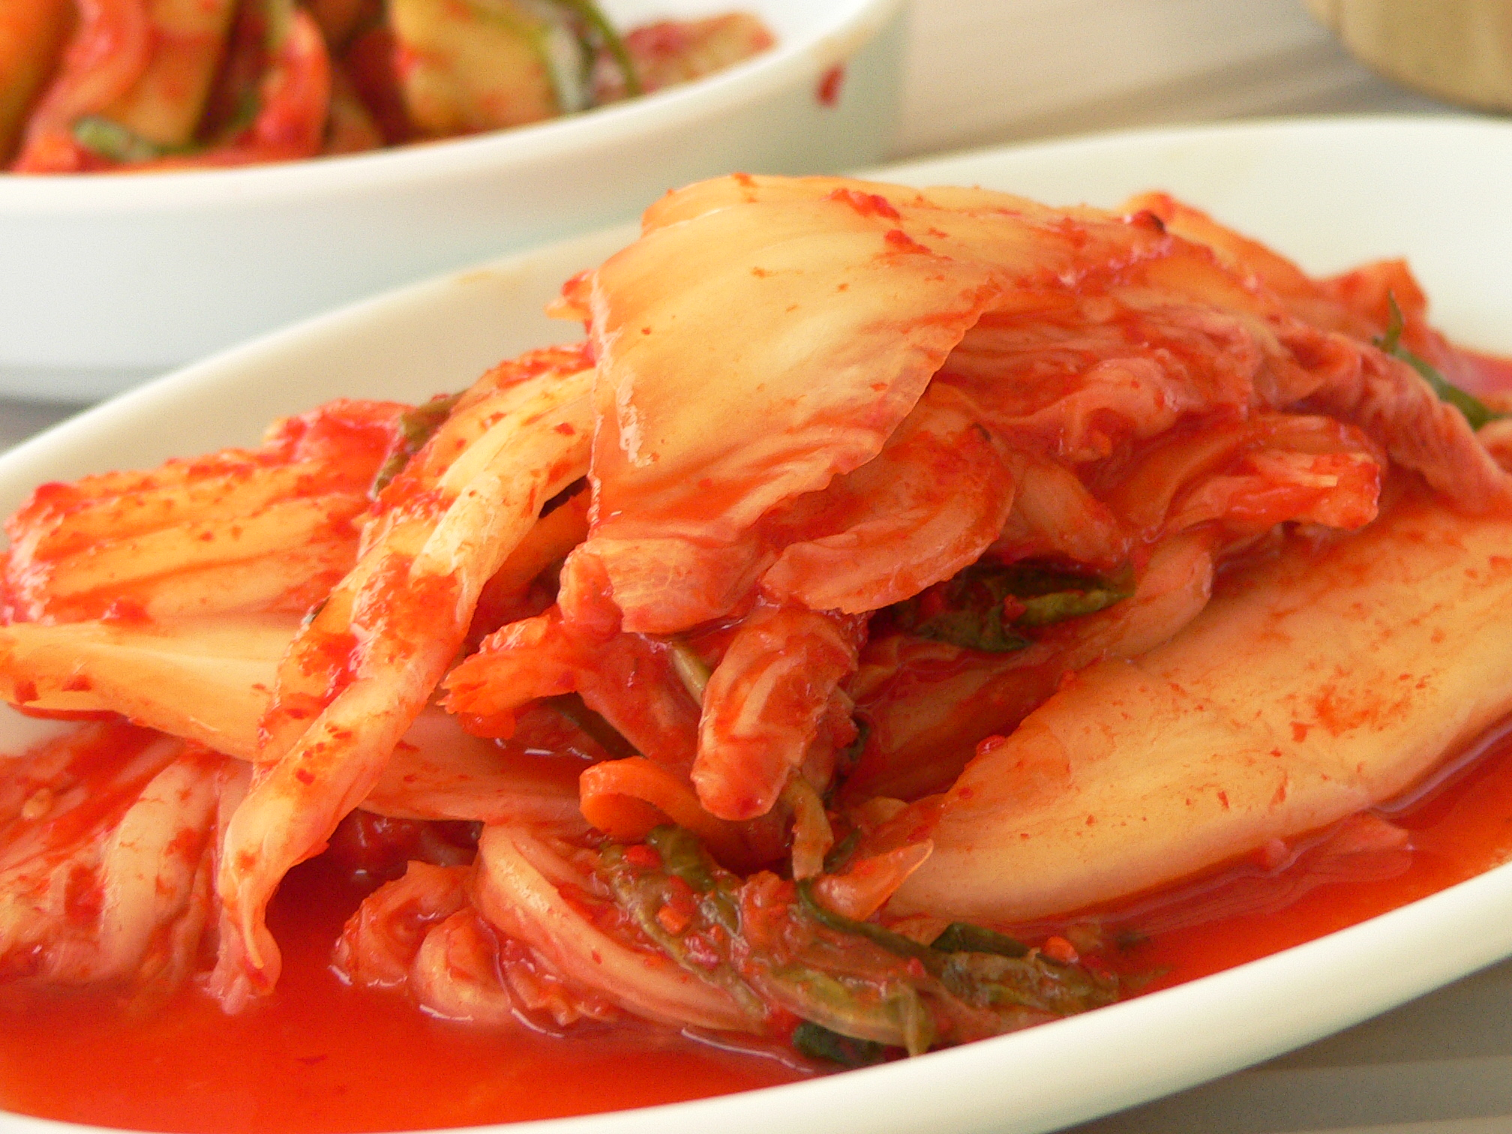
CS-US Contingency
Contingency “Experiment” in the Real World
Consuming Kimchi, stomach ache
Prob (US|CS) = 0.5, Prob (US|no CS) = 0, delta P = 0.5
CS
US
Prob (US|CS) = 0.5, Prob (US|no CS) = 0.5, delta P = 0.0
CS
US
Time →

Slide 28


CS-US Contingency
Contingency “Experiment” in the Real World
Dark Clouds, Rain
Prob (US|CS) = 0.5, Prob (US|no CS) = 0, delta P = 0.5
CS
US
Prob (US|CS) = 0.5, Prob (US|no CS) = 0.5, delta P = 0.0
CS
US
Time →

Slide 29
US Surprise
Blocking Experiment (Kamin, 1968)
Phase 1 Phase 2 Test
Gp 1 A - US AB - US B?
Gp 2 A | US (u) AB - US B?
Conditioned fear with rats (but other paradigms as well)
Stimulus A is Tone, Stimulus B is Light, US is foot shock
In Phase 1, A is paired with the US in Gp 1 but unpaired with the US in Gp 2
In Phase 2, both groups receive training with an AB compound stimulus.
Learning about stimulus B is blocked by prior learning to stimulus A
This is true even though B is paired with the US equally often in both groups
Once again, temporal contiguity is NOT sufficient
The US needs to be surprising in order for it to support new learning

Slide 30
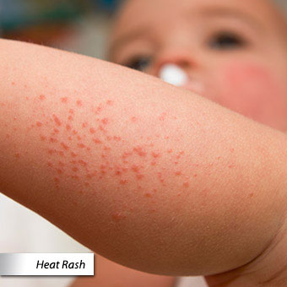
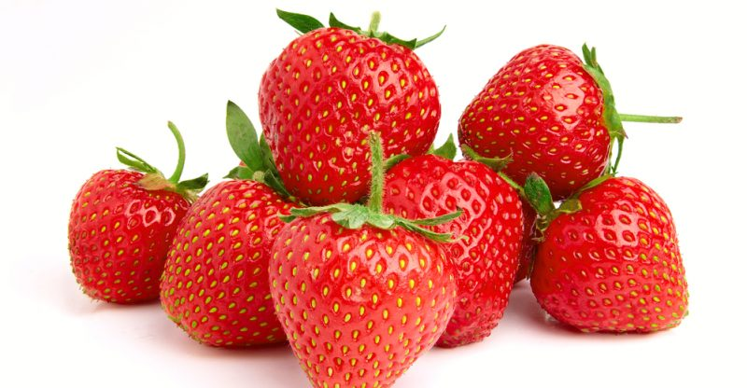
US Surprise
Blocking “Experiment” in the Real World
Phase 1 Phase 2 Test
Gp 1 A - US AB - US B?
Gp 2 A | US (u) AB - US B?
Strawberries – Rash | Strawberries + Oysters – Rash
Do you blame it on the Oysters or Strawberries???
Control condition: Somebody eats Strawberries + Oysters and gets a Rash,
but they never consumed strawberries alone…

Slide 31
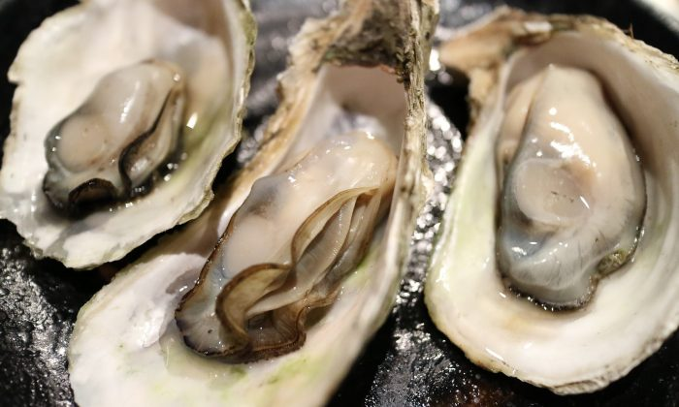
US Surprise
Blocking “Experiment” in the Real World
Phase 1 Phase 2 Test
Gp 1 A - US AB - US B?
Gp 2 A | US (u) AB - US B?
Strawberries – Rash | Strawberries + Oysters – Rash
Do you blame it on the Oysters or Strawberries???
Control condition: Somebody eats Strawberries + Oysters and gets a Rash,
but they never consumed strawberries alone…

Slide 32
Relative Cue Validity
Relative Cue Validity Experiment (Wagner, et al, 1968)
Phase 1 Test
Gp 1 AX+, BX- X?
Gp 2 AX+/-, BX+/- X?
Conditioned fear with rats, conditioned eyeblink with rabbits
Two compound stimulus trials intermixed throughout training in each group
Learning about X is less in Group 1 relative to Gp 2
X’s conditioning depends upon its “validity” relative to that of its partner
In Gp 1, X is a relatively poor predictor of the outcome, but in Gp 2 it is just as good
as its partners

Slide 33
Summary of these last 3 (“cue competition”) effects
US Surprise Governs Conditioning
Blocking - Understood in terms of US surprise
Contingency - Blocking by Context
Relative Cue Validity - Blocking by more valid cue

Slide 34
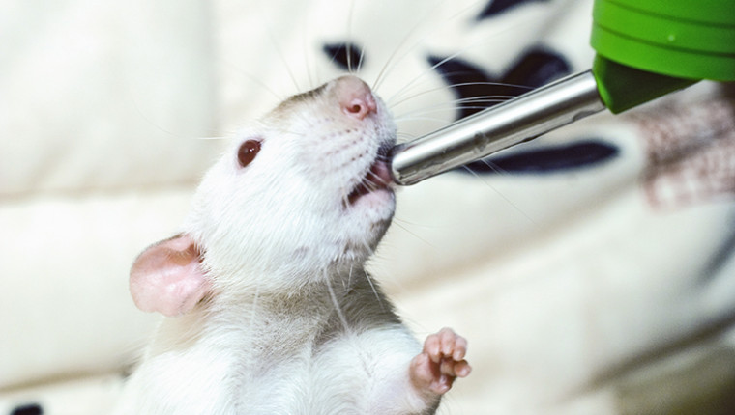
CS-US Relevance (or “Belongingness”)
Stimulus-Reinforcer Interaction Experiment (Garcia & Koelling, 1966)
Taste aversion/avoidance learning in rats
Rats learn to avoid a taste+audio+visual compound stimulus paired with Shock
in Gp 1 or Sickness in Gp 2.
Subgroups are then tested with either taste alone or the audiovisual stimulus alone.

Slide 35
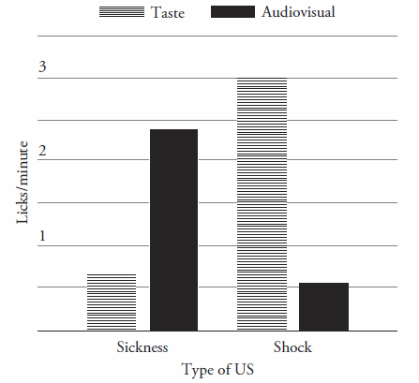
CS-US Relevance (or “Belongingness”)
Stimulus-Reinforcer Interaction Experiment (Garcia & Koelling, 1966)
Taste aversion/avoidance learning in rats
Rats learn to avoid a taste+audio+visual compound stimulus paired with Shock
in Gp 1 or Sickness in Gp 2.
Subgroups are then tested with either taste alone or the audiovisual stimulus alone.
Rats avoid the audiovisual stimulus if Shock was the US, but taste if Sickness was the US.
Some combinations are better learned about than others. In other words, they are
“relevant” to one another or “belong” together.

Slide 36
Summary Determining Conditions Experiments
Lots of important conditions shown to influence the course of learning.
The most general statement is that two events will become associated
when they are concurrently processed. US surprise may affect US processing
as could other factors (such as temporal contiguity, spatial contiguity,
novelty, intensity).
CS-US relevance (or belongingness) may also introduce other factors (e.g.,
evolutionary constraints on learning or learning by spatial contiguity).

